Slide 1
IISE Global Performance Excellence Webinar Series:
AI Applications: Migration Strategies for AI in pursuit of 4.0
Our Speaker today and our Sponsor:
Jared Frederici, MBB
Senior Leader & Solution Architect & Engineer
The Poirier Group
IISE Coordinator
D. Scott Sink
IISE Performance Excellence and Op Analytics Volunteer Lead
Facilitator/Member, CISE
Jared Frederici Linkedin Page
11 Dec 2023

Slide 2
Agenda
11:00-11:07 Scott ‘tee-up’ the session
11:07-11:45 Jared Presentation
11:45-12:00 Short Q&A and Close-out

Slide 3
Housekeeping
1
Thank you for joining us!
We’ll share how to get access to the recording, presentation several times throughout this webinar.
We will field questions as appropriate and time permits. Please use the ‘chat’ function to share your comments and questions.
Follow up questions are welcomed and contact information is provided at the end of the presentation.
For those who value certificates of participation, IISE will be mailing those out the week after the webinar. Be patient and check your clutter and spam folders if you don’t receive one.
There is a short survey at the end that we’d appreciate you completing
2
3
4
5
6

Slide 4
125 Timely Webinars on a full spectrum of Performance Excellence topics with an Integrated Systems Engineering Perspective and Point of View. Available on-demand for IISE members. Clustered into packages of webinars to provide tailored Certificate opportunities for our Members. 1--Operational Excellence 2--Integrated LeanSigma 3--Operational Analytics 4--Change Leadership & Management
Strengthen your Resume and Linkedin Page!!
Main Landing Page for all our Perf Exc Webinars

Slide 5
For the other AI webinars in our mini-series…
IISE Perf Excellence Webinars On-Demand Link

Slide 6
IISE Global Performance Excellence Webinar Series
AI Foundations:
ISE Perspectives and
Points of View
Our Panelists today:
Ben Amaba, Ph.D. , P.E.
Sonatype
https://www.linkedin.com/in/benamaba/
Matheus Scuta, MBA
Sr. Consultant, Deloitte
https://www.linkedin.com/in/matheus-zanatelli-scuta/
Jared Frederici, MBB
Leader, Delivery & Solutions
The Poirier Group
IISE Coordinator
https://www.linkedin.com/in/jaredfrederici/
D. Scott Sink
IISE Performance Excellence and Op Analytics Volunteer Lead
Facilitator/Member, CISE
Jon Carmona
Director of Data Analytics
Gardens Alive
https://www.linkedin.com/in/jonathan-carmona/
8 August 2023

Slide 7
IISE Global Performance Excellence Webinar Series
AI Risks and ISE Perspectives on Risk Management
Our Panelists today:
Ben Amaba, Ph.D. , P.E.
Sonatype
https://www.linkedin.com/in/benamaba/
Matheus Scuta, MBA
Sr. Consultant, Deloitte
https://www.linkedin.com/in/matheus-zanatelli-scuta/
Jared Frederici, MBB
Leader, Delivery & Solutions
The Poirier Group
IISE Coordinator
https://www.linkedin.com/in/jaredfrederici/
D. Scott Sink
IISE Performance Excellence and Op Analytics Volunteer Lead
Facilitator/Member, CISE
Jon Carmona
Director of Data Analytics
Gardens Alive
https://www.linkedin.com/in/jonathan-carmona/
5 September 2023
Chapter #1
Columbus, OH

Slide 8
IISE Global Performance Excellence Webinar Series
AI Sensemaking:
Foundations, Dimensions of AI, Strategy-People-Process to migrate to Industry 4.0 and AI
Our Presenter today:
IISE Coordinator
D. Scott Sink
IISE Performance Excellence and Op Analytics Volunteer Lead
Facilitator/Member, CISE
3 October 2023
Chapter #1
Columbus, OH

Slide 9
IISE Global Performance Excellence Webinar Series
AI Sensemaking: how is AI and 4.0 playing out?
Our Panel today:
Eleke Ukpabi
VP Solution Engineering & Strategy
Ruan
https://www.linkedin.com/in/elekeukpabi/
Victoria Jordan
VP Quality and Patient Safety
Emory Healthcare
IISE Coordinator
https://www.linkedin.com/in/victoria-jordan-800371106/
D. Scott Sink
IISE Performance Excellence and Op Analytics Volunteer Lead
Facilitator/Member, CISE
Chris Wisniewski
VP Operations Performance
Consumers Energy
https://www.linkedin.com/in/cwiz/
Yves Belanger
Sr. VP Supply Chain
Sobey’s
https://www.linkedin.com/in/yvesbelanger/
Chapter #1
Columbus, OH
14 Nov 2023

Slide 10
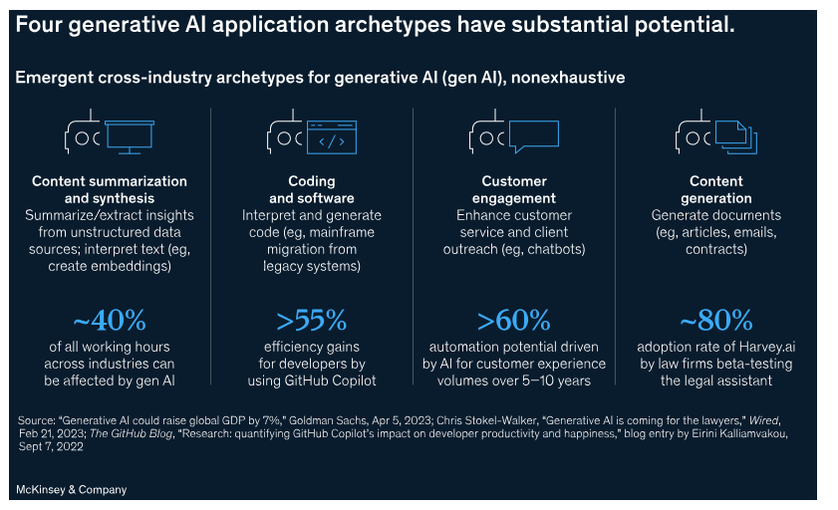
Before we launch into you presentation, I found this slide in an article from McKinsey
Unlocking the potential of generative AI: Three key questions for government agencies
December 7, 2023 | Article How generative AI can help governments maximize their economic potential | McKinsey

Slide 11
Artificial Intelligence
What is AI?
Artificial intelligence is the theory and development of computer systems able to perform tasks that normally require human intelligence¹.
What is it useful for?
Automating tasks, analyzing data, and improving decision-making.
Image Source: Link
Examples
Retail
Supply Chain
Manufacturing, Assembly, & Operations
Private Equity & Financial Services
IT & Business Services
Health & Life Sciences
Government & Public Sector
Dynamic Pricing
Dynamic Pricing
Equipment Predictive Maintenance
Algorithmic Trading
AI-Driven Incident Response (Cybersecurity)
Medical Image Analysis
AI-Enhanced Emergency Response Systems
Automated Inventory Management
Dynamic Network Optimization using AI APIs
Precision Assembly Robotics
Credit Scoring Models
Service Desk with NLP
Smart Traffic Management
Revenue Cycle Management Collections
Source 1: Oxford Languages and Google - English | Oxford Languages (oup.com)

Slide 12
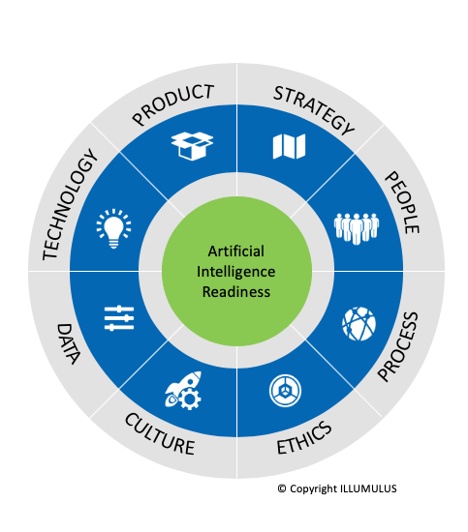
Understanding The Need For AI
Considerations
Develop your business case on what originally drove the need for AI solutions - think back to fundamentals!
Clarity in business pain points will set you up for a clearer technology roadmap
What are my business challenges?
What are my business goals?
What change is my organization capable of?
Why AI?
Readiness
AI IMPLEMENTATION
AI READINESS
AI EXPLORATION
AI Readiness (illumulus.com)

Slide 13
Solution Overview – AI & Business Process Automation
Core Solution:
Assessment to understand where the client is and where they need to be based on their objectives
Sub-Solutions: Enabled by the core solution, implementation efforts to capitalize and scale capabilities
Examples: Specific sample deliverables of sub-solutions capitalizing on AI capabilities
Types of AI Capabilities:
Product Recommendations
ML Implementation
Prediction Models
Narrow, Single-Point Solutions
Process / Problem Focused
AI Transformation
ClientGPT
NLP Implementation
AI and Business Process Automation
Call Centre Chatbots
Quick efficiencies
Independently small, but cumulative
Significant value
Example: RPA deployments
Considers common processes
Replicable for organization-wide rollout
Example: Call Centre Chatbots, ClientGPT
Fundamental business improvements
Combination of AI and organization/ process changes
Example: Prediction Models
Cognitive AI
Audio & Video Processing
PowerAutomate
RPA Deployment
Automation Anywhere
UiPath
14

Slide 14
Am I a Good Candidate for AI Applications?
Evaluate your use-case to avoid applying AI to the “wrong” places:
Symptoms of a “Good” Candidate | Symptoms of a “Bad” Candidate
Defined business problem(s) | Lack of understanding of pain points and undefined goals
Complexity in your processes | Decisions based on incomplete information
Efficient, standard, and repeatable processes | Process gaps and inefficiencies that require addressing before technology solutions
Available data that’s trustworthy | Poor data quality, inadequate infrastructure
Appropriate resourcing | Lack of tech-talent/qualifications
Environment culture that embraces continuous improvement | High resistance to change
Related Considerations
Organizational Readiness
Process & Governance Readiness
It’s likely that your organization is comprised of both good AND bad candidates…
Data Structure & Content Readiness
IT Architecture & Infrastructure Readiness
Workforce Readiness

Slide 15
How is AI Different from other integrations?
AI integration is a multifaceted process that requires a more intricate approach
AI deployment is widely variable, and can be done at scale:
Image Source Reference Link
Enterprise
Mid-
Market
In-house AI Teams & good infrastructure
Various Departmental AI integration
Cutting-edge technologies
Small /
Family
owned
Existing solutions, customized
Focused-departmental approach
Outsourcing AI Services
Focused-use cases
Plug & play form of technology
Requires a steeper learning curve for complexities
Data-dependent on high quality data
Continuous Adaptation and Innovation
Interdisciplinary Expertise Requirements
Ethical and Regulatory Considerations
Long-term flexibility

Slide 16
How Enterprise Process Maps (EPM) Can Help
EPMs
An EPM is a visual representation or diagram that outlines the various processes, workflows, and activities within an organization.
How EPMs Are Used
Comprehensive overview of the interrelations and contributions of departments and functions to the business
Insight to how current processes flow to reveal any process gaps or inefficiencies
EPMs and AI Readiness:
Help to conduct a detailed analysis of process complexity
Assessment in the need of technology improvements, or other improvements (such as operations)
To identify opportunities for AI integration (full or partial)
Evaluate the feasibility of integrating AI technologies
Prioritize AI implementation based its alignment with your business goals.

Slide 17
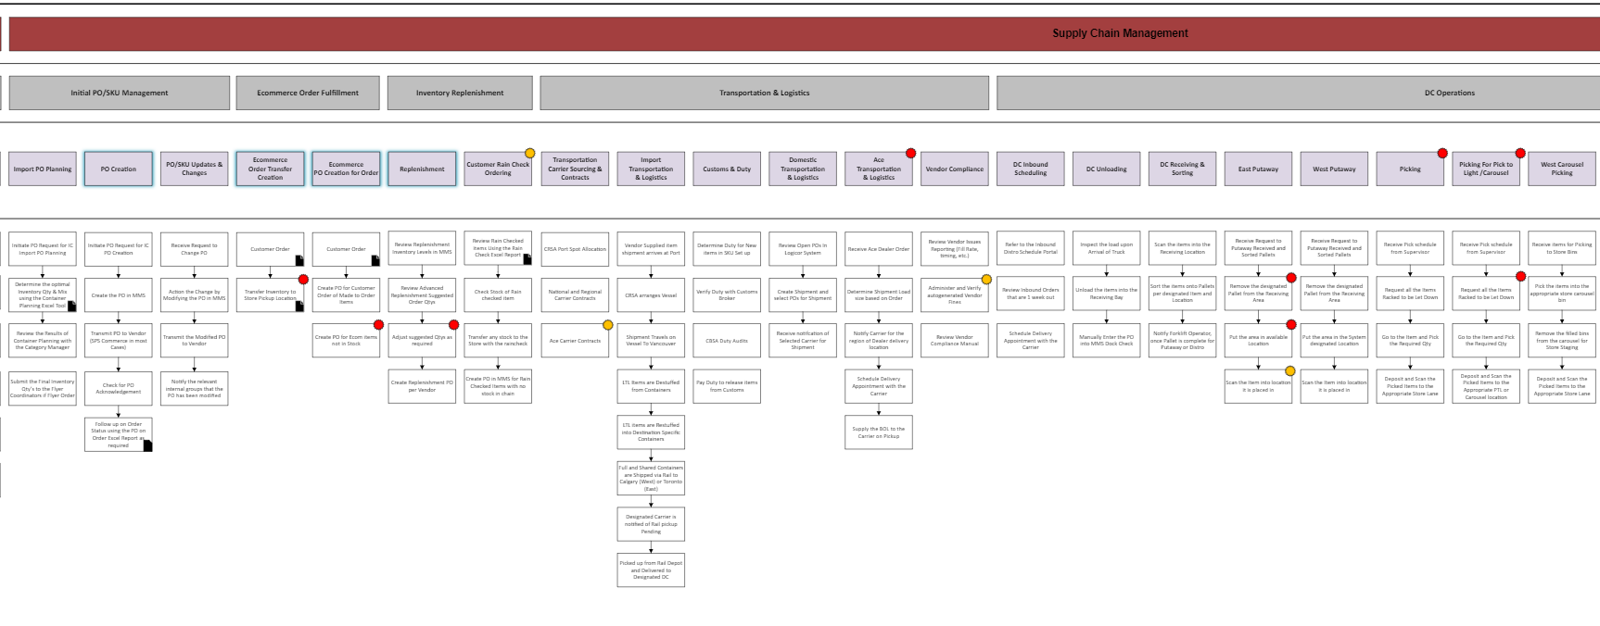
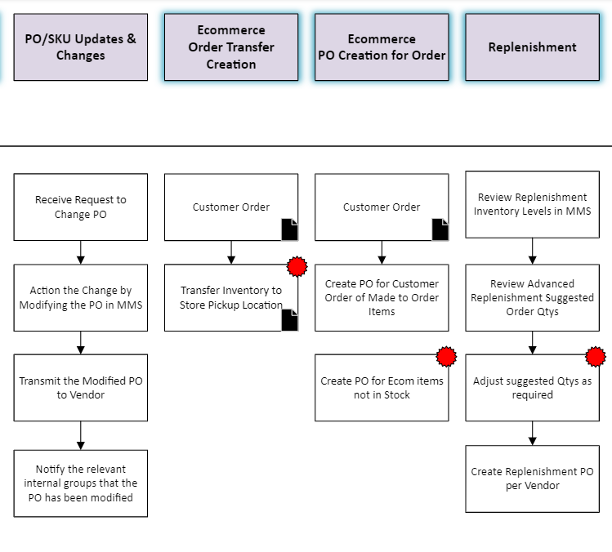
Process Identification Example 1
Purchase Ordering
Challenges
Potential AI Solutions
Outputs After AI Integration
AI In Purchasing: contains several manual tasks required, with room for errors and inefficiencies. Some pain points of Manual PO processing are:
Manual data entry
2-way/ 3-way / 4-way PO Matching¹
Touchless processing
Manual invoice routing
Optical Character Recognition¹
Smart Matching
Invoice to payment matching
Faster Payment Cycle
Discrepancies, duplicates, missing invoices
Compliance/ regulatory reporting issues
1 Purchase Order (PO) Matching - Automate with AI (nanonets.com)

Slide 18
Process Identification Example 2
Inventory Replenishment
Challenges
Potential AI Solutions¹
Outputs After AI Integration
AI in Inventory Management: By analyzing historical sales data, trends, and other factors, AI can assist in inventory management by providing resilience in overcoming supply chain variability.
Fixed re-order points and order quantities
Demand Forecasting
Improved Demand Forecasting Accuracy
Repetitive, time-consuming order adjustments
Inventory Management Systems (IMS)
Cost savings
Delays
Predictive Analytic Algorithms
Dynamic Replenishment
Stockouts and Overstocks
Automated Approval Workflows / ERP Integration
Automated Processes
Real-time visibility and tracking
Source 1
Source 2
19

Slide 19
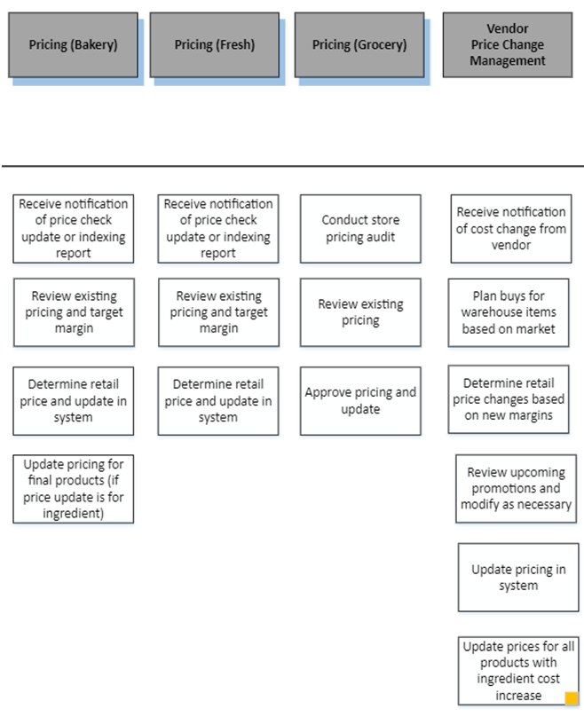
Process Identification Example 3
Dynamic Pricing
Challenges
Potential AI Solutions¹
Outputs After AI Integration
AI In Pricing: AI in pricing an include automating price checks and marketing trend analysis to dynamically adjust retail prices to maximize margins, improving responsiveness to market fluctuations. For instance, price change or index update reports may require manual reviews to adjust prices for optimal cost savings.
Manual evaluation on complex data for multi-factor decision making
Automated Pricing Data Analytics for Insights
Price Alignment with Promotion Goals
Dynamic Pricing Algorithms
Automatic Price Updates for target margins
Rapid market and customer behavior changes
ML enhancements to Demand Forecasting
Excessive and reactive efforts and checkpoints
Adaptive Pricing Strategies
Multi-factor, data-driven decision making
20
20

Slide 20
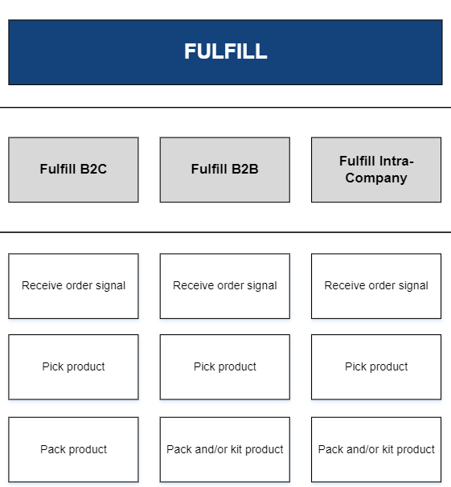
Process Identification Example 4
Discrete Event Simulation
Challenges
Potential AI Solutions¹
Outputs After AI Integration
AI In Supply Chain: AI in supply chain has many applications, from automated alerting of mined data to provide modeling of visibility of international freight, to dynamic supply chain network node analysis to scenario analysis for choosing a 3PL/4PL, vendor scorecarding models & procurement (among others).
Manual evaluation on complex data for multi-factor decision making
Real-time, predictive international freight models
Probability of failures and mitigation plans
Where to build, 10 year NPV
Rapid market and customer behavior changes
Broader network design and scenario analysis
Excessive and reactive efforts and checkpoints
Optimal “make” vs. “buy” procurement analysis & vendor scorecarding
Dynamic vs. reactive scorecarding
21
21

Slide 21
Examples of Companies using AI
Netflix – Recommends your next show or movie to watch, based on Machine Learning algorithms based on preferences, patterns, etc.
Salesforce – Automates their processes and conducts predictive analysis on big data using machine learning and natural language processing.²
Whirlpool – Automates its repetitive manufacturing tasks on its assembly line with RPA ³
Samsung – Error and quality identification is assisted by AI through vision recognition support ³
Image Source
“an estimated 25% of small business respondents in a May 2023 survey said they are using or testing generative AI …” ¹ – U.S. Chamber of Commerce

Slide 22
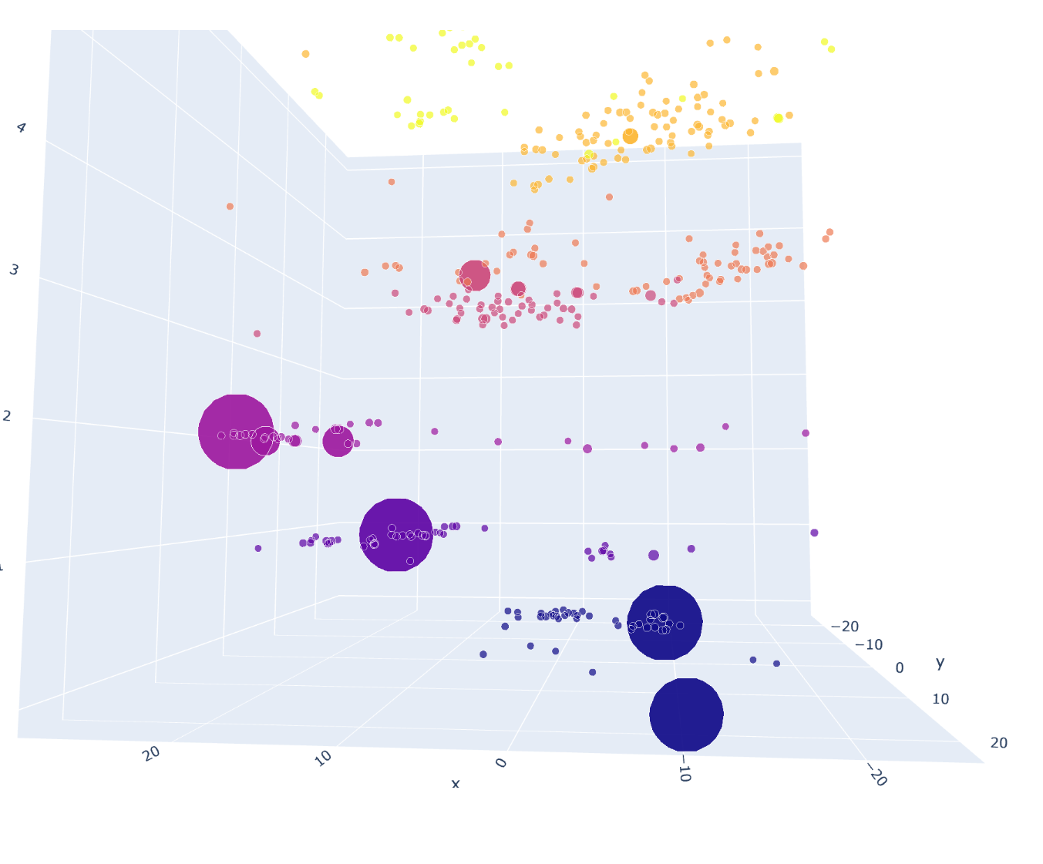
TPG Internal Use Cases
Paint Point Identification and Relationship Mapping
Identifies from large volumes of complex data
Classifies and groups into themes
Clear pain point relationships
Initial solution design
Automated Process mapping With Unstructured Data
Process maps produced from transcript inputs
Re-purposed time for process gap assessments
Shifted efforts from administrative to value-add
Standard format for deliverables
Increased capacity
AI-Support in Proposal and Innovative Solution Assessments
Reduced Lead Time
Quality enhancements
Marketing Analytics and Insights
Prevented fraud-clicks on pay-per-click ads
Historical post performance & visitor grouping
Strategic marketing and optimized ad spending

Slide 23
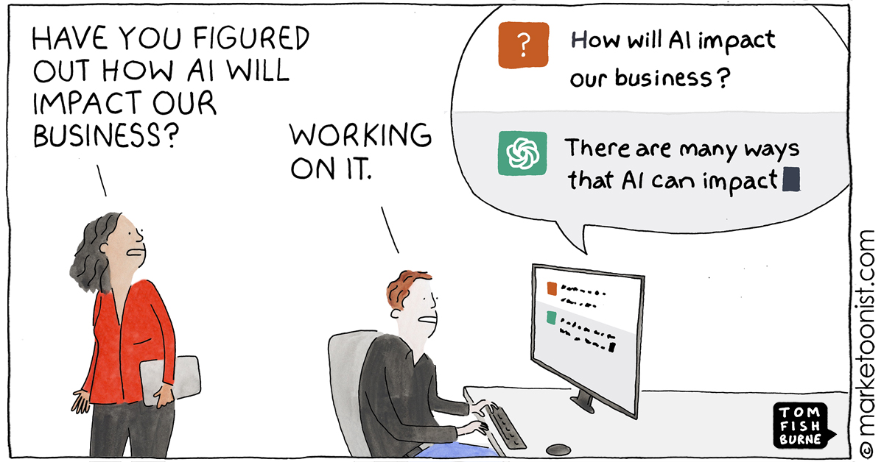
Summary
High-Level Strategy
Understand The Underlying Need
Go back to basics and clearly define your organizational goals and prioritized pain points
Exploration and Discovery
Understand and acknowledge AI capabilities and industry trends
AI Readiness and Self-Assessments
Symptoms of good and bad candidates
AI Tidal Wave cartoon - Marketoonist | Tom Fishburne
Before You Begin: AI Deployment at Scale
Business size considerations
Having an organization-wide perspective, and considering how this will affect other factors
Leveraging the Enterprise Process Map
Identify and prioritize a strategic approach to solving your pain points

Slide 24
Jared, here’s a few questions for you..
Some AI integration will undoubtedly happen by ‘osmosis’ with SME’s. I gather you are ‘arguing’ for leaders of SME’s to be more aggressive in advancing the introduction of “AI” to ensure competitiveness through ‘smart automation’?
I shared some practical illustrations of AI at work in AI 301. Automated Cruise Control, Grocery Coupons, and the Home Depot photo part finder app, others abound. What are some other common examples and opportunities you see, beyond what you shared in your presentation?
applying ‘technology enablement’, AI as example, has to stay focused on the right competitive advantage outcomes. How does an SME ensure that they don’t end up investing in things that don’t realize, manifest benefits that matter?
IISE is hosting an AI and Industry/Service 4.0 Symposium on Saturday, 18 May. Some outstanding Subject Matter experts are being assembled to share their insights, perspectives, points of view. Another good reason to join us in Montreal in May!! More on this….

Slide 25
IISE Annual Conference—Montreal!!
CISE Performance Excellence Track (Sunday)
The Senior Leader of the ISE function in organizations like Boeing, GM, Flex, UPS, Disney, Emory Healthcare, Duke Healthcare, Sobeys, The Poirier Group and 13 more share their insights, experiences, points of view and suggestions for how you can create improved Excellence in your domain.
ISE Capstone Showcase and Leadership and Student Mixer (5:00-5:30 Sunday)
We’ll have the ‘Sweet ‘16’’ in both categories for you to view, that’s a lot of fun to meet all the students on the teams and understand their great work.
That Showcase will occur in the context of the larger leadership and student mixer, so it’s networking at it’s best.
Best Practices in Service Systems Engineering Finalists (Sunday am)
Final Four of the Capstone Competition (Monday am)
IISE Honors and Awards Event (Monday evening)

Slide 26
December Offerings for you..
1--December 14th--World Economic Forum Global Lighthouse Initiative and Network Overview for ISE’s
Join me for this wonderful opportunity to come to understand this Global Initiative that is a community of manufacturers showing leadership in using Fourth Industrial Revolution technologies to transform factories, value chains and business models, for compelling financial and operational returns.
Register using this link: REGISTER for Overview of the Global Lighthouse Initiative
2--December 19th—Change Leadership and Management 101
Join me as we launch our miniseries in Change Leadership and Management. I’ll lay the foundation for this series by sharing the principles for sound Change Leadership and Management as organizations continue to strive for Operational Excellence.
Register using this link: REGISTER for Change Leadership and Management 101

