Slide 1
IISE Global Performance Excellence Webinar Series:
Operational Analytics 301: Detailed Design & Development—Synthesis and Integration of ‘Components’
Our Speaker today and our Sponsor:
D. Scott Sink, Ph.D., P.E.
Senior Advisor
The Poirier Group
IISE Coordinator
Scott Sink Linkedin page
D. Scott Sink
IISE Performance Excellence and Op Analytics Volunteer Lead
Facilitator/Member, CISE
18 July 2023

Slide 2
Agenda
11:30-11:40 Scott to ‘tee-up’ the session, go back to go forward just a bit
11:40-12:15 Detailed Design & Development of “B” Systems
how to accelerate systematic improvement
12:25-12:30 Scott close out and overview OA 501 and also our upcoming Mini-Series on AI

Slide 3
Housekeeping
1
Thank you for joining us!
We’ll share how to get access to the recording, presentation, YouTube versions and blogs at the end of the webinar. The presentation is available now, use this link to get.. (we’ll post as a chat)
We will field questions as appropriate and time permits. Please use the ‘chat’ function to share your comments and questions.
Follow up questions are welcomed and contact information is provided at the end of the presentation.
For those who value certificates of participation, IISE will be mailing those out the week after the webinar. Be patient and check your clutter and spam folders if you don’t receive one.
2
3
4
5
Thanks to our Sponsor and Partner for investing time, money, energy programming and directing this overall Program for IISE!

Slide 4
Our 2023 Mini-Series’ :
Strategies for Riding the Waves of Disruption
Supply Chain Management 4.0/5.0
Operational Analytics
AI

Slide 5
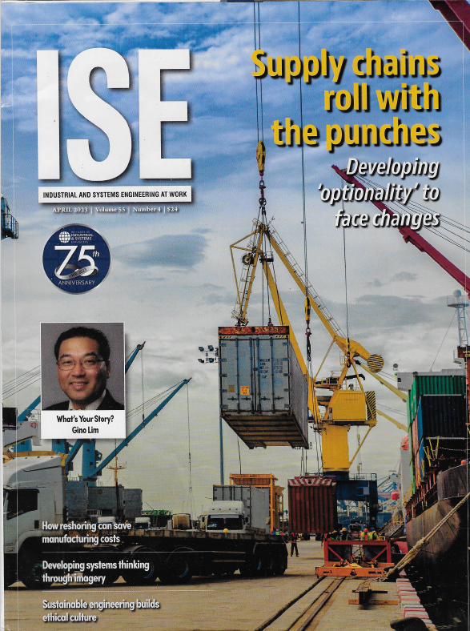
Membership has it’s Privileges….
Look for our Feature Article from our Operational Analytics Mini-Series in August!!!
Aug 2023
April 2023
Dec 2022

Slide 6
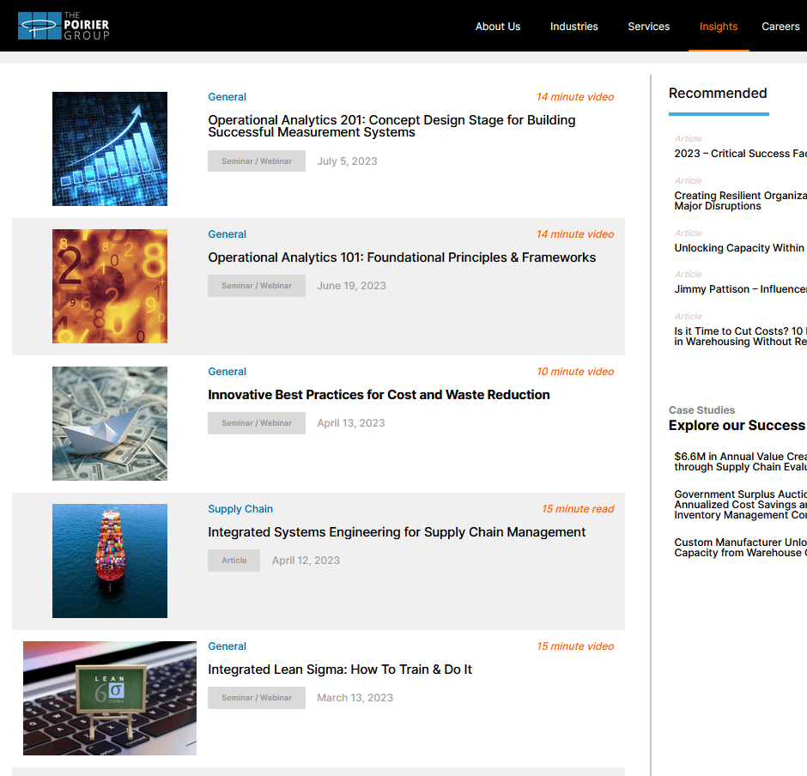
Visit The Poirier Group’s Website to access shorter versions of these Webinars (snippets)
https://www.thepoiriergroup.com/perspectives/
Or go to the TPG YouTube Channel for the short and longer version.
https://www.youtube.com/channel/UCixxhLPZrwdK-DdKYqYZm1A

Slide 7
100+ Timely Webinars on a full spectrum of Performance Excellence topics with an Integrated Systems Engineering Perspective and Point of View. Available on-demand for IISE members. Clustered into packages of webinars to provide tailored Certificate opportunities for our Members. 1--Operational Excellence 2--Integrated LeanSigma 3--Operational Analytics 4--Change Leadership & Management
Strengthen your Resume and Linkedin Page!!
IISE Global Performance Excellence on-demand Webinar Library

Slide 8
How do we design, develop, build and execute better ‘B’ Management Systems
The focus of todays OA 301 Webinar is on Synthesis and Integration:
Why does this matter, what’s the Purpose, Why is this important?
How do we go about Engineering better Management Systems that will drive performance and process improvement faster and better?
What are the system components for a ‘Great’ BPI/Org’l Excellence Program/System that need to be ‘built out’ and integrated?
How do we make all this doable, less overwhelming?
What are the Pragmatic First Steps?
On to an ISE view of AI…..

Slide 9
End Game for our Performance Improvement Efforts—Growing Enterprise Value
Average
Stakeholder
Relationship
Duration
Ideal
The ‘End Game’ is to Optimize the Lifetime Value of various stakeholders in the system (customers, internal and external; employees; shareholders; the business)
There is a science and there are explicit methods that can be utilized to do this
Formalized Performance Improvement Programs (e.g. Op Ex) can have huge impact
Blended, broad, balanced views and capabilities on types of improvement methods is required.
Greater
Longevity
Full Potential
1.0
Ideal
Average
Stakeholder
Relationship
Value
Created
Enhanced
Behavior
1x
1.0
1.0
Increased Geog. / Segment Scope/
Ideal
Quantity of Stakeholder Relationships

Slide 10
END GAME: Grow Enterprise Value
POSITIONING STRATEGY
VALUE EXCHANGE
OPTIMIZATION
OPERATIONAL
EXCELLENCE
25x
50x
10x
1x
Improve Positioning via..
Geographic Coverage / Offerings Provided / Served Segments / Branding/ Imaging, etc.
Managing the Exchange of Value
With Stakeholders
Altering the Give/Get,
Responding to unmet and unfulfilled needs, QFD, Innovation, Rebalancing Segment
Investment
Improve Quality, Efficiency,
Productivity, Innovation, Engagement, Quality of Work life, Sustainability
Apply principles and methods of ISE and ILSS
The Domain of ISE and Operational Analytics is very broad today
Notes:
Notes:

Slide 11
Building Management Systems to Optimize “B”
A—”Administer”, perform the role, run the process as designed, etc….
C—’Cater’ to crises (fight fires).
D—’Do’ the Dumb (non-value add, waste, …)
B—”Build” the business, BPI, PDSA, etc.
Common Current State
‘B’ gets squeezed out by ‘C’ and ‘D’
Low maturity, capability, competence to do systematic ‘B’
‘A’ teetering on the brink, high variation in process capabilities
‘B’ portfolio not rationalized, ad hoc and hence impact sub optimized
Desired State
‘B’ is driving ‘C’ and ‘D’ out of business, systematically over time
A Great BPI ‘function’, Op Ex best in class
‘A’ process capability improving dramatically due to better and faster ‘B’
The ‘B’ portfolio is aligned to Enterprise Strategy top to bottom and front to back.
Mgmt. Systems Eng. & Op Analytics to Build Better ‘B’

Slide 12
Context – The Purpose of Operational Analytics
Facilitate & Enable the creation of ‘solutions’ that catalyze and enable better decisions faster
and then drive actions, improvement implementation, faster
and then drive benefits realization faster (desired and positive outcomes)
and then grow Enterprise Value (system, process, business value creation).

Slide 13
Succeeding at Operational Excellence and Analytics—why it’s a big deal
$60
A Transformation that Dave played an integral role in…
Built to Last Data
$6

Slide 14
Why does it
Matter
Personalized healthcare
Predictive medicine & AI
Our aspirations to improve the delivery of care is limited by our ability to see, understand and use data
Population Health
Non-traditional care environments
Data
Fragmented, siloed and quality unknown
Efficiency & Optimization
Analytics
Inability to respond to analytics use cases
Inconsistency
Results vary from different sources
Slow Decisions
Decision cycles limited by access to data
Michael Caesar, Chief Data & Analytics Officer, UHN, 2022
Caesar (2019) https://www.linkedin.com/pulse/future-data-driven-healthcare-we-only-knew-what-know-michael-caesar/
Data & Analytics

Slide 15
How do we design, develop, build and execute better ‘B’ Management Systems
The focus of todays OA 301 Webinar is on Synthesis and Integration:
Why does this matter, what’s the Purpose, Why is this important?
How do we go about Engineering better Management Systems that will drive performance and process improvement faster and better?
What are the system components for a ‘Great’ BPI/Org’l Excellence Program/System that need to be ‘built out’ and integrated?
How do we make all this doable, less overwhelming?
What are the Pragmatic First Steps?
On to an ISE view of AI…..

Slide 16
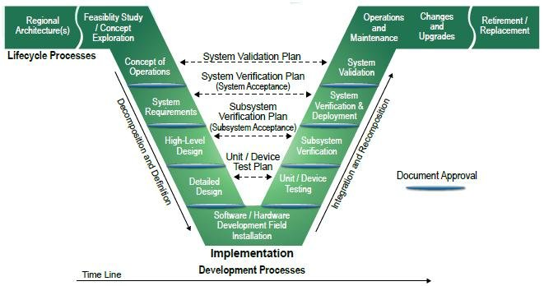
Design for… approach to Management Systems Engineering
Define
Concept Design
Detailed
Design & Development
Optimize
Verify
OA 101
OA 201
OA 301 & 501
OA 401

Slide 17
Design for… approach to Management Systems Engineering
Define
Concept Design
Detailed
Design & Development
Optimize
Verify
101
Strategic Context
Key Stakeholder Analysis
Management System Model
Management System Analysis
Value Stream Mapping and Analytics
MSM Interface Requirements Definition
Control Point Metrics and Spec Limit determination
201
BPI capability and capacity
Enterprise level Value Stream Mapping and Modeling (Enterprise Value Map)
BPI Portfolio Strategy and Development
Tiered Scorecard and Dashboard and Chartbook Concept Development
Visible Measurement System
Tiered Huddle System (as example)
301
BPI capability and capacity
Enterprise level Value Stream Mapping and Modeling (Enterprise Value Map)
BPI Portfolio Strategy and Development
Tiered Scorecard and Dashboard and Chartbook Concept Development
Visible Measurement System
Tiered Huddle System (as example)
401
Measuring what matters
Data and Fact Driven Organization
Enterprise Value growing at best in class rates
B continually driving out ‘C’ and ‘D’
Focused innovation and improvement
Alignment and coordination top to bottom, back to front
Discipline with ‘A’ and ‘B’
Accountability, Trust, Culture
Information (Profound Knowledge) and Insights and Bias for Action and Results

Slide 18
Full Potential Performance Strategy is aimed at effectively and efficiently migrating towards the far back right corner of the Performance Cube
Customer Solution Design / Delivery
Goal
Cross-Enterprise Integration
Interfaced Strategies
Stove-pipe BU’s & Functions
Process
Improvement
Capability
Maturity
5.0 Optimized
4.0 Managed
Drive to Full Potential Performance
3.0 Defined/ Specified
2.0 Practices
1.0 Adhoc
Stakeholders are: Employees, Customers, Shareholders, Suppliers, etc.
BPI Focus
Products / Functions
Superior Value Chain Performance
Stakeholder Value Exchange (Lifetime Value of Customer)
Objective Function

Slide 19
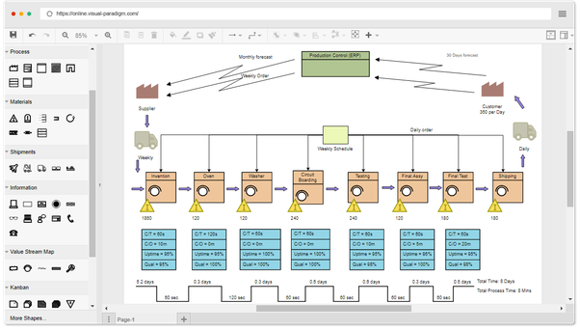
Organizational Systems, Extended Enterprises down to the smallest process is this happening..
Leadership & management team
(wisdom application, data/facts to information conversion process)
Information perception/ understanding/ insights
Information portrayal
Data management and Operational Analytics
Decisions
Data entry
Actions
Data capture
Upstream Systems and Inputs:
Suppliers & customer orders
The Business Processes/Value Streams/Processes
Downstream Systems and Outputs:
Orders Fulfilled

Slide 20
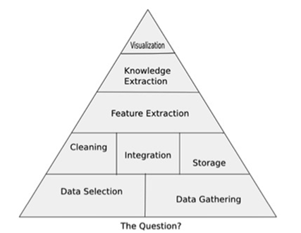
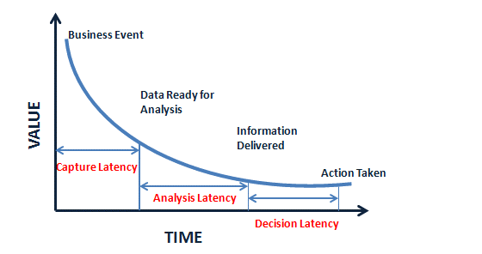
How to Build Better ‘Dials’ on your ‘Dashboards’ and ‘Scorecards
Key Points to Consider:
Good analytics come from good context understanding, use case clarity, good problem/opportunity statements, clear understanding of DONE, they specify ‘the questions’
Investment in the data foundation has a positive ROI, as analysts and users move faster when they trust the data – results in faster results
Good data visualizations can tell the right story quickly, because people are predisposed to believe what they see in a chart …
Good Operational Analytics provokes more timely decisions and actions – indeed, in most organizational systems, simple and persuasive/influential beats complex/ambiguous every time
Good Operational Analytics provokes more timely decisions and actions – indeed, in most organizational systems, simple and persuasive/influential beats complex/ambiguous every time
TPG can help your organization speed things up and achieve Better Benefits Faster. Contact us.

Slide 21
Rounding the Corner on the Model is a Critical to Success Skillset for the Analyst
Information perception/ understanding/ insights
Information portrayal
Leadership & management team
(wisdom application, data/facts to information conversion process)
Data management and Operational Analytics
Data Organization
Decisions
Data entry
Actions
Data capture
Data capture
Data capture
Data capture
Upstream Systems and Inputs:
Suppliers & customer orders
The Business Processes/Value Streams
Downstream Systems and Outputs:
Orders Fulfilled
Data capture
Data capture

Slide 22
Objective: build out the capability to do the top half of the Op Analytics Process DO-TRAIN/COACH Approach)
The BPI/Analytics Support Team:
Results and Benefits Realization
Decisions-Actions
Insights
Understanding
The BPI/Analytics Team:
The Implementation Science and Benefits Realization Role doesn’t exist yet (PMO)
The Questions
The Analyst Role: doesn’t exist yet
User Interface to Power BI output: (Data Management Role)
The Data Management Role: (Exists as Silo)
Data Sources, MMS, SQL tables, Query tools, and what’s called Feature Extraction in the form of Reports/Tables/some charts
The Questions/Needs
We need to get this going from top to bottom instead of bottom to top!!

Slide 23
Getting to Visualizations that create insights (aha moments) that provoke timely decisions and actions and improvements is the key
Timely Benefits Realization
Must do, Accelerate ability to cycle bottom to top on the OA Triangle
Improved Alignment of OA work with Strategy—better portfolios due to leveraging better OA
integrate data creatively, from multiple sources, rapidly using best tools available
Visualizations must minimize the latency to get to the “Ah-Ha” moment and then drive the causal chain to Benefits Realization

Slide 24
How do we design, develop, build and execute better ‘B’ Management Systems
The focus of todays OA 301 Webinar is on Synthesis and Integration:
Why does this matter, what’s the Purpose, Why is this important?
How do we go about Engineering better Management Systems that will drive performance and process improvement faster and better?
What are the system components for a ‘Great’ BPI/Org’l Excellence Program/System that need to be ‘built out’ and integrated?
How do we make all this doable, less overwhelming?
What are the Pragmatic First Steps?
On to an ISE view of AI…..

Slide 25
What are the components of the ‘Management System’ (‘B’)
Visible Measurement Systems (Knowledge of Results, Accountability)
Scorecards, Dashboards, Chartbooks (PowerBI)
‘B’ System
Measurement, Evaluation, Analytics Systems
Communication and Coordination
Motivation—Ideal Behavior Assurance
‘Technology’ Enablement—includes Process design
Deployment Process
Planning System
Alignment top to bottom, front to back (e.g. Hoshin Kanri)
Agile Huddles & Retrospectives (Sharepoint)
Tiered PDSA Huddles (Communication & Coordination)
Knowledge of Results, Growth Needs, Engagement
Augmented Processes with Tech Enab. (quality & speed)
Job Enrichment (augment, enable people for them to do higher order tasks and innovate)

Slide 26
BPI Contributions to MDS Pursuit of Full Potential Performance
Measurement & Evaluation to Support Improvement:
Fact/Data Based Decision-Making
Planning System:
Strategy and Policy
Implementation and Deployment;
Organizational Alignment/
Effectiveness
System & Process
Improvement
(e.g. Business Process
Reengineering/Improvement)
Focused Improvement: Consistency of Methods, Standards of Excellence, Assessments, Benchmarking
Full Potential Performance
Change Leadership &
Management:
Full Potential
Condition of Mind
Program & Project
Management
Discipline
(Benefits Realization)
Stakeholder Value Exchange
Management
Information & Technology Enablement
to Provoke Timely & Effective
Decisions and Actions

Slide 27
Simpler Version of Essential Components (top 5)
Infrastructure for Architecture & Engineering, Design and Development, Implementation and Deployment, Governance and ongoing Alignment and Engagement
Strategy and Policy Deployment (some version of Hoshin Kanri)
‘Management System’ Framework, Model—explicit, tailored, practical
PDSA System, infusing ‘B’ (Transformation, Reinvention, Reengineering, Continuous Improvement) into the way everyone works
Tiered Huddle System
Visible Measurement/Management System (Op Analytics)

Slide 28
Leadership Alignment & Support Infrastructure was a Critical Early Factor
Program Initialization
Engage the ‘Right’ People
Pick the Right Projects
Best in Class Training
Discipline around Methodology
Celebrate Successes to get the ‘fly wheel’ spinning
BPI Core Team
LeanSigma and Op Analytics Architecture and Engineering
Executive Sponsors
CEO & President
MDS
CIO
CFO
EVP
Org. Dynamics
President LOB 1
President LOB 2
President LOB 3
President LOB 4
BPI Administrative Coordinator
LeanSigma Deployment Leaders
and Managers
Master Black Belt Support—Training, Coaching
SME’s (Finance , IT, HR, REF, SCM, Regulatory Rep’s)
Value Stream Owners/Managers & Process Owners (Champions)
Program & Project Management Support
‘Belts’
Core Teams
Subject Matter Expertise Support
1) Pick the right belts and 2) surround them
with the support requirements they need to be successful.
Notes:
Next X to address was the alignment and support from the people that would be leading, managing, participating, and championing the projects.
Gained upper management support from CEO and his senior management team
Established VSO’s who are accountable for value streams (series of processes that generate a product or service)
Money Belts – validate finances
Other subject matter experts
Technical support / Program Management from our team, the Business Process Improvement Team
Notes:

Slide 29
We’ve done several webinars on Strategic Performance Improvement Planning
The essence of Hoshin Planning is doing planning in a way that ensures Alignment AND Quality in the Strategies and Plans.

Slide 30
Simpler Version of Essential Components
Infrastructure for Architecture & Engineering, Design and Development, Implementation and Deployment, Governance and ongoing Alignment and Engagement
Strategy and Policy Deployment (some version of Hoshin Kanri)
‘Management System’ Framework, Model—explicit, tailored, practical
PDSA System, infusing ‘B’ (Transformation, Reinvention, Reengineering, Continuous Improvement) into the way everyone works
Tiered Huddle System
Visible Measurement/Management System (Op Analytics)

Slide 31
IISE Best Practice Case Studies in Analytics:
University Health Network—Toronto
JULY 14, 2023

Slide 32
The Five Fundamental Pillars For Change At Scale
VISION & LEADERSHIP
Articulate a vision (North Star) of driving business change using data & analytics and provide executive support to motivate and influence the improvement journey
BUSINESS VALUE
Develop an effective strategy to ensure the implementation of targeted use cases to realize business benefits
OPERATING MODEL
Deploy an operating model to better organize data capabilities and develop, deploy, & operate analytics solutions
GOVERNANCE & POLICIES
Establish robust rules and processes to ensure an organizational culture that promotes responsible use of data
TECHNOLOGY
Build data architecture and deploy an analytics platform to scale analytics solutions across the organization

Slide 33
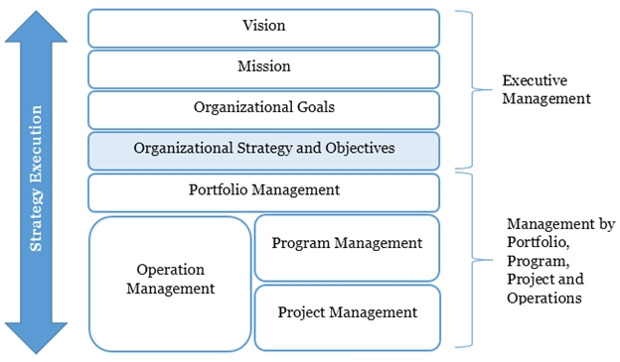
Organizations need a vehicle to execute the strategy
Bi-directional link from strategy to operations
“Run the business - change the business”
Structure to manage the complexity
Structure to promote collaboration (no silos)

Slide 34
Simpler Version of Essential Components
Infrastructure for Architecture & Engineering, Design and Development, Implementation and Deployment, Governance and ongoing Alignment and Engagement
Strategy and Policy Deployment (some version of Hoshin Kanri)
‘Management System’ Framework, Model—explicit, tailored, practical
PDSA System, infusing ‘B’ (Transformation, Reinvention, Reengineering, Continuous Improvement) into the way everyone works
Tiered Huddle System
Visible Measurement/Management System (Op Analytics-to support and drive Study-Adjust)

Slide 35
NEED….
We’ll need some ‘mechanism’ for engaging teams and individuals in focused ‘B’ work.
Organizational Strategic Performance Improvement Planning is required with features/functionalities that ensure engagement, alignment, visibility, discipline, and accountability.
Tiered Huddle Systems are becoming more popular and can be a key component in any BPI initiative. (we’ve done several webinars on these solutions)

Slide 36
Lean Operational Stability A tiered huddle approach to engage staff, solve problems and always be prepared for patient care, even through disruption Victoria Jordan, PhD, MS, MBA Vice President – Quality and Patient Safety

Slide 37
Why does EHC need a lean operating system?
Patients and families receive care that is subject to variation in processes that can produce negative health and financial outcomes as well as unpredictable experiences
Providers of care and those supporting them are overburdened in doing their work
Considerable waste is generated by the minute, hour, and day that challenges the operating system of EHC
This results in great people using suboptimal processes to achieve variable outcomes at high cost
We stand by our mission, vision, and values, and believe that Lean Operating System is a vehicle that will enable us to better execute on those
Improved Team Experience
Lower Costs
Improved Patient Experience
Better Outcomes

Slide 38
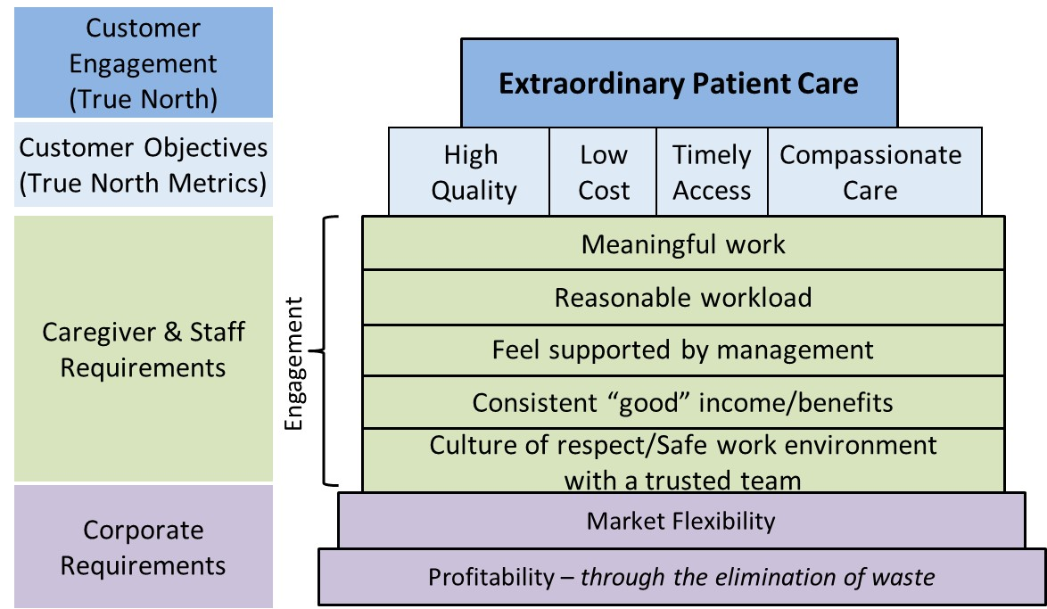
Mindset: Lean Operating System Value Proposition
Notes:
Lean Value Proposition
To remain effective, healthcare services need to deliver higher and more reliable quality, safer care, and faster patient access—and accomplish all of this at the lowest possible cost.
However, Lean is really a system for delivering mutual success (Toyota refers to this as mutual prosperity) for the customer (patient), the staff/associates, and the enterprise.
That means success for the patient measured by the quality, cost, timeliness, and empathetic delivery of care.
That means success for the caregivers and staff as measured by reasonable, meaningful work that is supported by the organization’s leadership.
That also means that the enterprise delivers profitability to shareholders and contributes positively to society.

Slide 39
Lean Operating System
Notes:
The Lean Operating System
This house illustrates the Lean Operating System.
The goal of level 1 is people development regarding education and alignment on a patient-centered system.
The goal of level 2 is reliable outcomes that meet patient needs. This level includes proactive activities such as ensuring supplies and equipment are available and ready to go when needed, establishing administrative and clinical standards, and initiating efforts to create flow. This level is also where managers learn how to be Lean leaders by working with their teams to fix problems that hamper everyday work.
The goal of level 3 is to match capacity to demand through level loading and understanding the cadence of patient demand (takt time). It is also when important business structures need to be altered, including the implementation of workflow control and long-term capacity and demand planning.
Level 4 establishes a takt (cadence) environment. At this level, key work elements of clinicians and staff are standardized including the amount of time to perform each step and balancing that time to cadence. Level 4 also requires a higher degree and faster rate of problem solving.
Level 5 is when the bar is raised so that existing standards cannot be met without improvement.

Slide 40
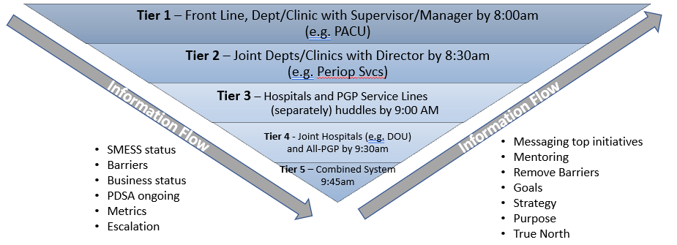
EmPower: Defining the Journey Level 1 - Foundation
Improving Communication through the Organization:
The first major goal of EmPower was to stand up a daily tiered Readiness & Problem Escalation huddle system
The “Tier 5” System huddle launched in May 2019

Slide 41
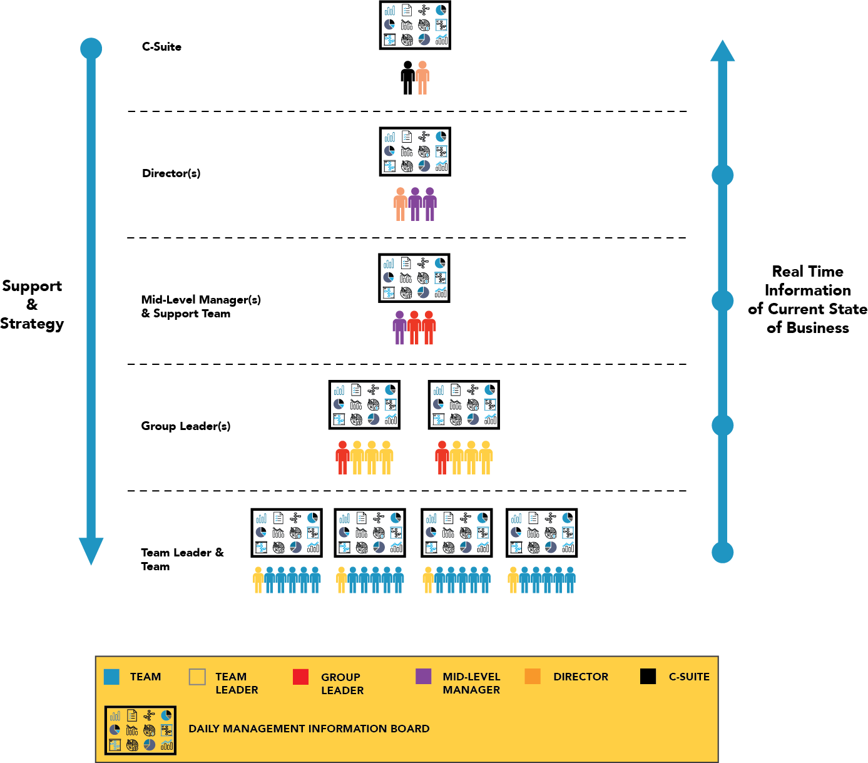
Performance Huddles
Tiered Huddles
In general, this image depicts the structure of “Tiered Huddles”

Slide 42
Simpler Version of Essential Components
Infrastructure for Architecture & Engineering, Design and Development, Implementation and Deployment, Governance and ongoing Alignment and Engagement
Strategy and Policy Deployment (some version of Hoshin Kanri)
‘Management System’ Framework, Model—explicit, tailored, practical
PDSA System, infusing ‘B’ (Transformation, Reinvention, Reengineering, Continuous Improvement) into the way everyone works
Tiered Huddle System
Visible Measurement/Management System (Op Analytics-to support and drive Study-Adjust)

Slide 43
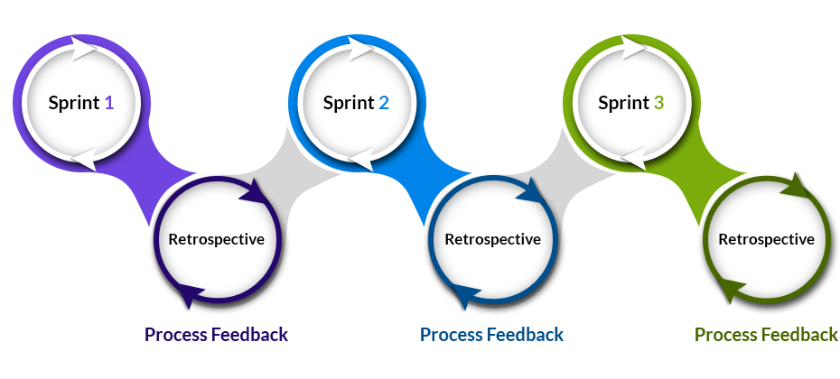
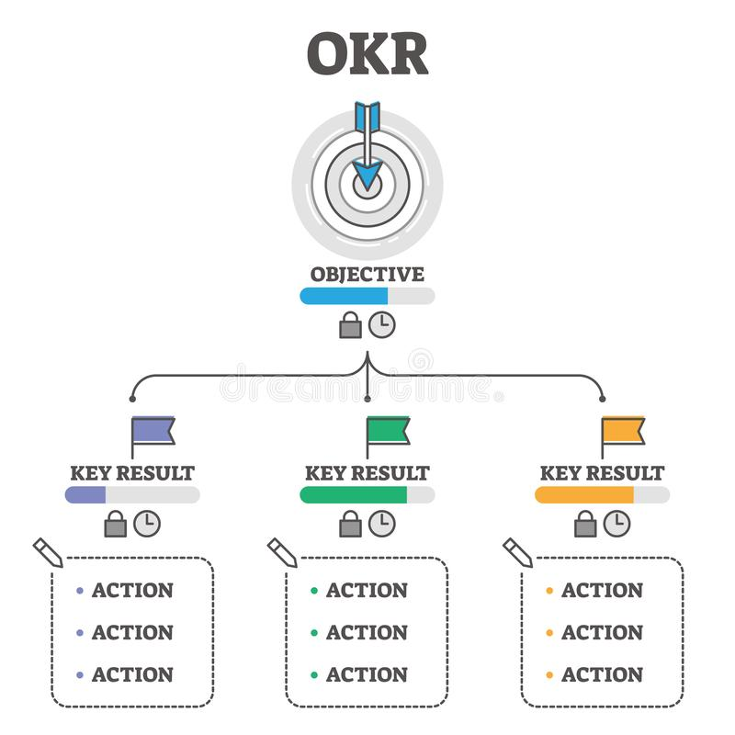
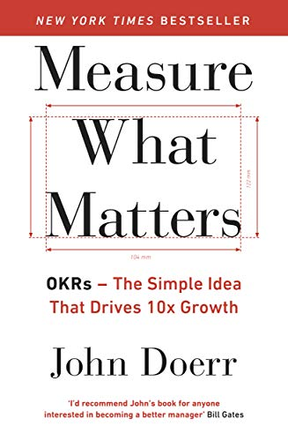
How can you do this really fast?
Notes:
Agile, Sprints, OKR’s, leadership alignment, speed of trust …..
Explain OKR briefly and how it connects with what we are talking about

Slide 44
Context – The Purpose of Operational Analytics
Facilitate & Enable the creation of ‘solutions’ that catalyze and enable better decisions faster
and then drive actions, improvement implementation, faster
and then drive benefits realization faster (desired and positive outcomes)
and then grow Enterprise Value (system, process, business value creation).

Slide 45
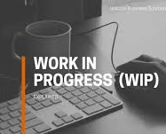
Steps in the “Build” of better PDSA systems
Peavey Performance Management/Measurement System
Operational Analytics (PBI & Sharepoint & Huddle Boards)
Understand the Voice of Users
2
4
Information Perception
Data Management
Leadership & Management
Information Portrayal
Data Portrayal
Data Management
5
Decisions
Data Entry
3
Data Capture
Huddles & Study-Adjust
Actions
Collect, Store, ‘Manage’ Data for Op Analytics
Positioning
Value Exchange Management
Operational Excellence
Suppliers
Customers
Customers
1
Map & Analyze the Value Stream

Slide 46
Moving from Big Data to Operational Analytics
Unknown, Unmeasured, Unthought about Data
Identify and figure out how to get

Slide 47
Strategy to migrate Current System to what you want
Common Situation with Organizations on the journey with MS365 solutions
Driving Results that are Sustainable
Much work ahead but will come quickly
Study-Adjust:
Strong Alignment on the need for this
Need BPI tiger team to point the way
Data Analytics:
Lots of work to do, directionally correct
Data Management:
Solid foundation to build on
Results and Benefits Realization
Decisions-Actions
Insights
Under-
standing
Most Org’s ‘Reports’ are, at-best, feature extraction

Slide 48
Objective 1: build out the capability to do the top half of the Op Analytics Process DO-TRAIN/COACH Approach)
The Development Support Team:
Results and Benefits Realization
Decisions-Actions
Insights
Understanding
The Development Team:
The Implementation Science and Benefits Realization Role doesn’t exist yet (PMO)
The Questions
The Analyst Role: doesn’t exist yet
User Interface to Power BI output: (Underdeveloped in most org’s)
The Data Management Role: (Underdeveloped and mis aligned to BPI)
Data Sources, MMS, SQL tables, Query tools, and what’s called Feature Extraction in the form of Reports/Tables/some charts
The Questions/Needs
We need to get this going from top to bottom instead of bottom to top!!

Slide 49
How to Build Better ‘Dials’ on your ‘Dashboards’ and ‘Scorecards
Key Points to Consider:
Good analytics come from good context understanding, use case clarity, good problem/opportunity statements, clear understanding of DONE, they specify ‘the questions’
Investment in the data foundation has a positive ROI, as analysts and users move faster when they trust the data – results in faster results
Good data visualizations can tell the right story quickly, because people are predisposed to believe what they see in a chart …
Good Operational Analytics provokes more timely decisions and actions – indeed, in most organizational systems, simple and persuasive/influential beats complex/ambiguous every time
Good Operational Analytics provokes more timely decisions and actions – indeed, in most organizational systems, simple and persuasive/influential beats complex/ambiguous every time
TPG can help your organization speed things up and achieve Better Benefits Faster. Contact us.

Slide 50
Getting to Visualizations that create insights (aha moments) that provoke timely decisions and actions and improvements is the key
Benefits Realization
Must do, Accelerate ability to cycle bottom to top on the OA Triangle
Improved Alignment of OA work with Strategy—better portfolios due to leveraging better OA
integrate data creatively, from multiple sources, rapidly using best tools available
Visualizations must minimize the latency to get to the “Ah-Ha” moment and then drive the causal chain to Benefits Realization

Slide 51
Example of data integration—hard work but rewards are worth it

Slide 52
More detailed look

Slide 53
How do we design, develop, build and execute better ‘B’ Management Systems
The focus of todays OA 301 Webinar is on Synthesis and Integration:
Why does this matter, what’s the Purpose, Why is this important?
How do we go about Engineering better Management Systems that will drive performance and process improvement faster and better?
What are the system components for a ‘Great’ BPI/Org’l Excellence Program/System that need to be ‘built out’ and integrated?
How do we make all this doable, less overwhelming?
What are the Pragmatic First Steps?
On to an ISE view of AI…..

Slide 54
Pragmatic first steps, baby steps…
At first glance, this is complex and overwhelming.
Once you wrap your heads around the concept design, most find it to be doable, there are tailored migration strategies and paths that even SME’s can cope with and succeed with.
I think it starts with the leadership acknowledging that a ‘B’ (BPI, Op Ex) component is required in the Leadership and Management infrastructure. A SVP of BPI as example. Making systematic ‘B’ a priority in the organizations strategy is an early requirement.
Then picking the right people to lead and develop the ‘B’ team is a critical to success requirement. Get the ‘B’ infrastructure right!!
Then augmenting the ‘B’ team with expert strategy guidance can often, is usually helpful to ensure things get jump started and launched effectively and efficiently.

Slide 55
I was recruited to lead the Operational Excellence ‘Plank’ in the MDS Enterprise Transformation in 2004 (reported to President of Enterprise Services)
Process
Outcomes
Business Performance Reviews
Weekly EMT teleconferences
Monthly business reviews
Disciplined annual plans
Action oriented decision making
Tighter accountability
Customer responsive
Better understanding of “A” performers; enriched career path
Expansion of variable compensation opportunity
Alignment of shareholder and management incentives
Talent Management
Biannual talent reviews
New executive compensation plan
Customer/ Competition/ Capital
Business unit/Corporate strategy
Detailed industry analysis
Customer value led process
Longer range growth agenda
Focused R&D investments
Capital matched to growth
Lean Sigma Roadmaps and Toolkit
Compliance Programs (EHS, Quality, etc.)
LeanSigma Practitioner Development
Balanced Improvement Portfolios
Standard approach across the Enterprise
Building global quality competitiveness, productivity improvement, process and cost efficiency, compliance and assurance
Simplify processes
Customer responsive
Operational Excellence
Notes:
Notes:

Slide 56
UHN’s Strategic Priorities
UHN’s Strategic Priorities
TeamUHN
Converge care, research & education
Technology & innovation
Canada as a world destination
Invent tomorrow’s care
Michael Caesar, Chief Data & Analytics Officer, UHN, 2022
Data & Analytics

Slide 57
UHN’s Data & Analytics Strategy
Data-driven decision making enabled across UHN
Liberated data assets for patient care, discovery and learning
Policies built to support and enable strategic pursuits
Strategically aligned enterprise data architecture
Standardized datasets and data management
Protect and unlock data through balanced infrastructure investment
Improved data literacy across UHN (UHN community at large)
Transparency through data in all that we do
Liberated capacity by balancing human-machine automation
Building UHN’s ability to see, understand and use its data to advance patient care, education and research
Empowered Leadership using analytics to drive novel care models
Supported insight and decision making through predictive analytics
Empowered staff building innovative solutions using data
Established partnerships supporting learning and development
Enabled ethical public-private collaboration in the use of data and insight
Michael Caesar, Chief Data & Analytics Officer, UHN, 2022
Data & Analytics

Slide 58
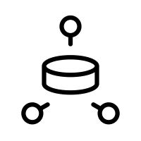
Enabling Insight
VISION
MISSION
To build UHN’s ability to see, understand and use its data to advance patient care, education, and research
Quality & Safety
Care Variation & Utilization
Care Equity & Models of Care
TeamUHN & Workforce
AREAS OF FOCUS
To increase understanding and measurement of care quality and patient harm across UHN and enable focused efforts of improvement
To enable visibility of resource utilization and care variation, identify opportunities for improvement and partner to build efficiencies and eliminate waste
To enable better visibility into UHN marginalized populations and identify and evaluate new models of care
To increase UHN’s insight and enable planning of its workforce, its well-being, and its future
Decision Intelligence
Analytics & Insight
Performance Management Systems
ROADMAP & DELIVERABLES
Dashboards & scorecards through visualization, storytelling tools & automation
Surface improvement opportunities and automate solutions through analytics, modelling, simulation & optimizing
Standard work supporting data exploration, benchmarking, KPI, registries, and improvement
STRATEGIC UNDERPINNINGS
Unified Data Framework
Data & Information Governance
Data & Analytics Literacy
Build Data Operations
Care, Admin, Research & Education
Care, Admin, Research & Education

Slide 59
Operating Model for Advanced Analytics in Healthcare - OMIX-H
Establish a centre of gravity
Create clear multi-directional connection (North & South, East & West)
Develop capability and capacity
Governance and oversight
Strategic pull and operational responsiveness
Strategy & Relationship Management
Change & Automation
Advanced Analytics & Insight
Analytics Literacy
Data & Information Governance
Data Technology & Operations
Caesar, et al. 2020. Connecting Data to Value: An Operating Model for Healthcare Advanced Analytics - Healthcare Quarterly
Data & Analytics

Slide 60
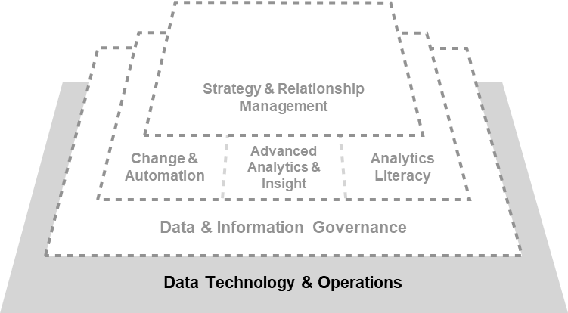
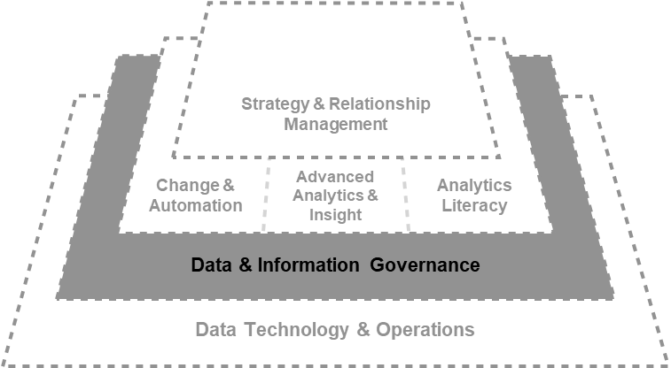
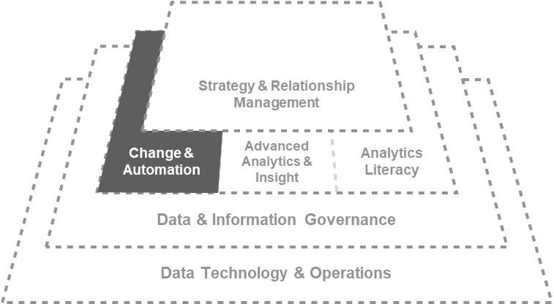
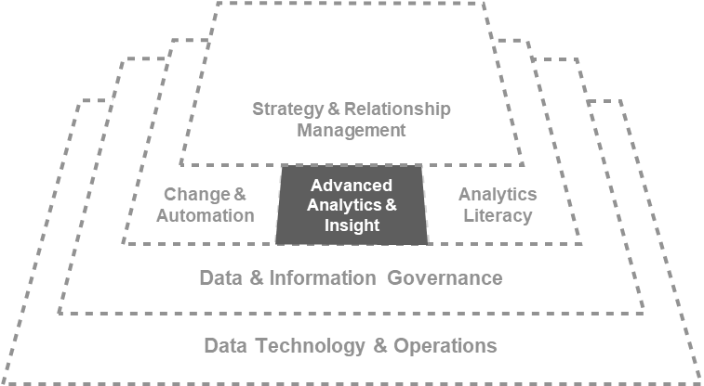
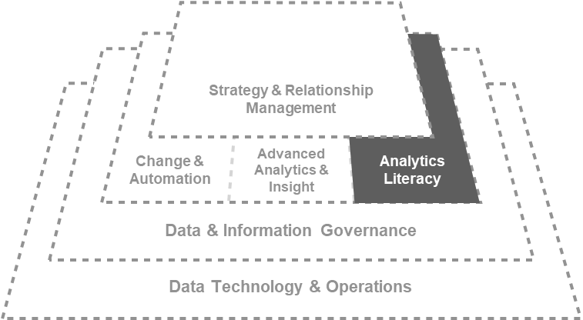
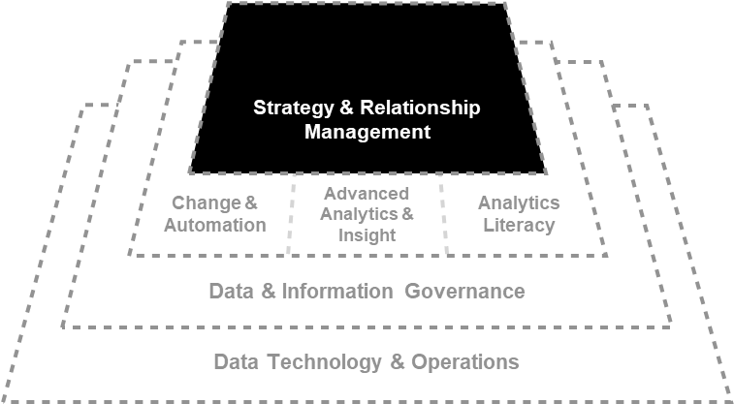
OMIX-H Components
Managing the flow of data and information required to develop analytics solutions
Serve in organizing efforts to manage, protect and enable value from enterprise data assets
Coordinate the implementation of advanced analytics solutions to ensure human and AI systems can work, interact and communicate with each other
Enable explorations insight generation and problem solving using data
Advance the organizations capabilities in understanding data, its collection, management and application
Stimulate, surface and shape the organization’s needs across all domains of the organization
Caesar, et al. 2020. Connecting Data to Value: An Operating Model for Healthcare Advanced Analytics - Healthcare Quarterly
Data & Analytics

Slide 61
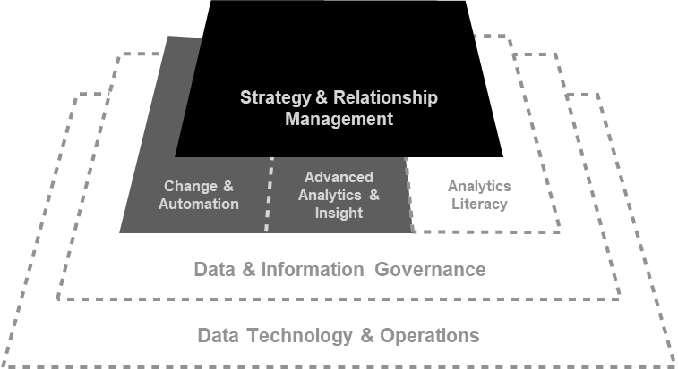
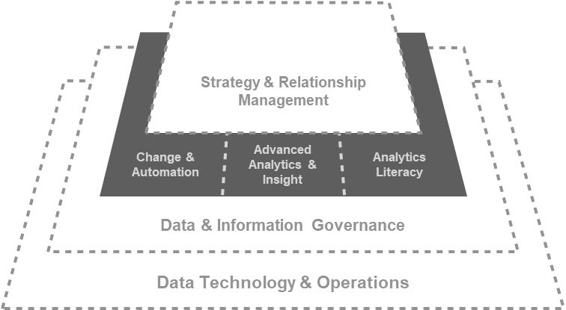
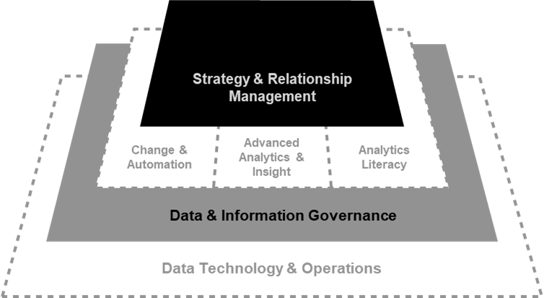
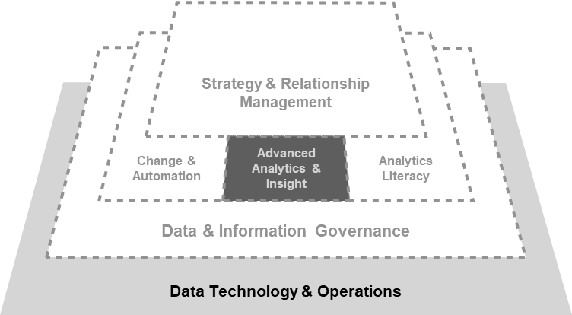
OMIX-H Interactions
PEOPLE/CULTURE & DATA LITERACY
Ensure that organizational culture and people capabilities advance with the introduction of need ways of doing work
PRIORITIZATION & INVESTMENT
Prioritization of advanced analytics or AI projects
RISK TOLERANCE
& STRATEGY
Ensure a balance between risk appetite and strategic pursuits
TECHNOLOGY & BUSINESS OPPORTUNITIES
Understand current and future needs to data technology and help align investment
Caesar, et al. 2020. Connecting Data to Value: An Operating Model for Healthcare Advanced Analytics - Healthcare Quarterly
Data & Analytics

Slide 62
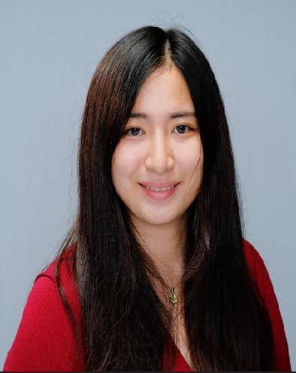
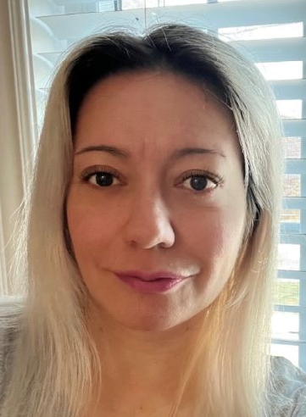
Decision Support Analyst
Our resident experts in informatics helping UHN understand its data and performance
Role:
Performance data quality, reporting and analytics for clinical and management teams
Skills:
Epic Cogito reporting, business intelligence, communication, and statistical analysis
Medical terminology and informatics proficiency
Database tools/programs (e.g. Crystal Reports, Power BI, SAS and Python)
Large healthcare data sets
Value proposition:
Provide accurate information and thoughtful insights on hospital performance to support operational and strategic evidence-based decision-making
Recommend innovative ways to improve reporting process efficiency and data quality
Example Contributions:
Stroke Accreditation
Blood Group Confirmation to ensure patient safety and optimal delivery of blood resources

Slide 63
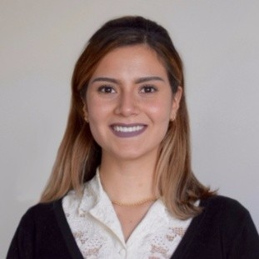
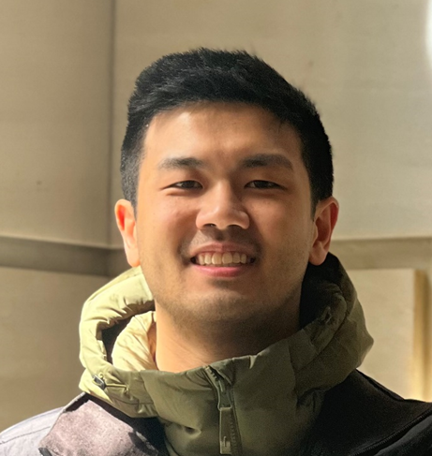
Analytics Consultant
Using data to solve problems and generate insight
Role:
Utilize analytics and data to understand and address healthcare challenges
Skills:
Simulation, predictive analytics, operations research, project management, and change management
Value proposition:
Leverage UHN data assets to develop innovative analytics solutions that improve the delivery of care and operations
Example Contributions:
Toronto General Hospital Simulation Model [inform medium and long-term capacity planning]
Primary Care Provider Data Visualization [understand patient/provider care in the community]
Emergency Department Predictive Model [forecast patient arrivals to inform staffing decisions]
Eating Disorders Program Model [understand available capacity and reduce patient wait times]

Slide 64
Data Storyteller
Helping UHN connect to its data, understand it, and take action
Role:
Convert business problems into decision intelligence solutions using data-driven visual stories to drive decision-making
Skills:
Data visualization, development methodologies, information architecture, data analysis, user interface design, agile product ownership, and change management
Value proposition:
Communicating complex data through storytelling to support patients and staff in making critical decisions
Example Contributions:
UHN Corporate Scorecard [inform Executive Leadership and Board on performance against North Star Indicators]
Patient facing Emergency Department (ED) wait times tool [inform patients and staff of expected wait to see a provider]
Patient Experience dashboard [understand and improve how patients’ experience care at UHN]
COVID-19 vaccine registry dashboard and portal [identify and prioritize eligible groups for vaccination]

Slide 65
How do we design, develop, build and execute better ‘B’ Management Systems
The focus of todays OA 301 Webinar is on Synthesis and Integration:
Why does this matter, what’s the Purpose, Why is this important?
How do we go about Engineering better Management Systems that will drive performance and process improvement faster and better?
What are the system components for a ‘Great’ BPI/Org’l Excellence Program/System that need to be ‘built out’ and integrated?
How do we make all this doable, less overwhelming?
What are the Pragmatic First Steps?
On to an ISE view of AI…..

Slide 66
And, Just Ahead…..
June and July Offerings for you..
An Analytics Mini-Series:
03 August—Operational Analytics 501—Tools and Methods to Sharpen your OA Skills
Register for OA 501
Capstoned by a Feature Article in the ISE Magazine in August.
August & September Sneak Preview
An ‘AI’ Miniseries
10 August AI 101-- https://link.iise.org/AI-part1
An ISE perspective on AI
September--Our Annual Final Four Capstone Senior Design Presentations
October 19—Best Practices in Service Systems Engineering

Slide 67
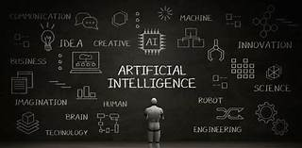
The Purpose of our upcoming AI Miniseries
Sense making in an everchanging World
ISE Perspectives and Points of view on AI

Slide 68
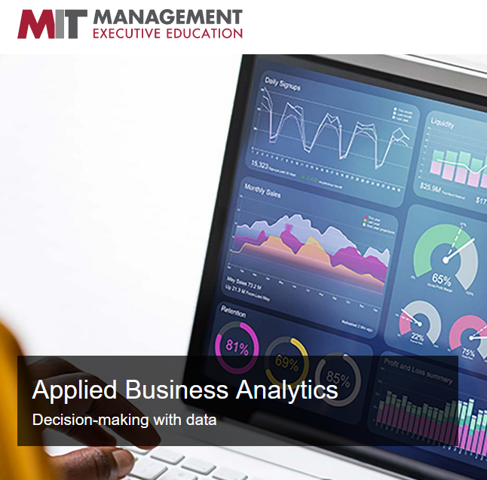
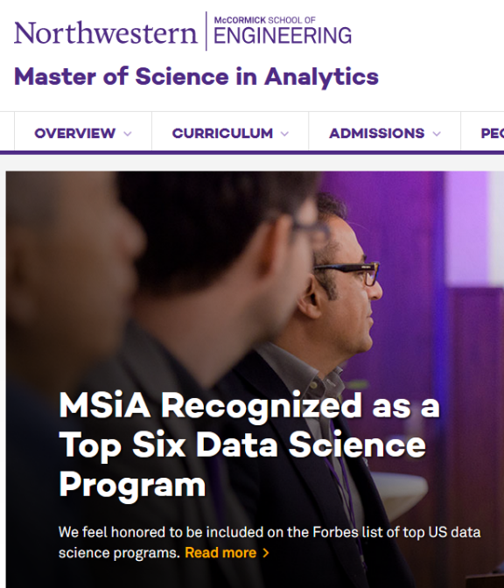
Op Analytics Development Options
120 hours ++, $400 students + $250 for certification
$475/675 member/non-member + $550 for the certification
4 days to 6 mos. $600-$5,000
1-2 yrs, $50-100k
Time/
Cost
On-Line, Virtual
On campus or Hybrid MS Programs
Hybrid/ Blended Model
https://careerfoundry.com/en/blog/data-analytics/best-data-analytics-certification-programs/

Slide 69
Op Analytics represents huge opportunity for ISE’s
In Partnership with:
The Poirier Group
Moresteam University
Delivered Uniquely:
IISE Digital Op Ex ‘Mall and Stores’
10+ Video Modules for easy, self-paced consumption/learning
‘Chat’ Support with Coaches
Periodic Huddles for virtual coaching
Certificate requires an on-line final exam
Certification requires the Certificate plus a reduction to practice, proof of skill project
Module 1: OA Thought Leader Perspectives
Module 2: Operational Analytics Perspectives, Points of View and Foundational Principles and Methods and Models
Module 3: Operational Analytics: The Foundational Data Management Role
Module 4: Operational Analytics: The Analyst, Decision/Action Support Role
Module 5: Data Sciences and The New Industrial and Systems Engineering
Module 6: Operational Analytics: The Evaluation Role
Module 7: Operational Analytics—Visual Measurement/Management Systems (Parts I, II, III)
Module 8: Operational Analytics: Putting it All Together: Case Studies
Module 9: The Role of Data and Information (Engineered Management Systems) in Periods of Major Disruption, Reducing the Latencies
Module 10: Creating Cultures that Support Full Potential Performance/Operational Excellence

Slide 70
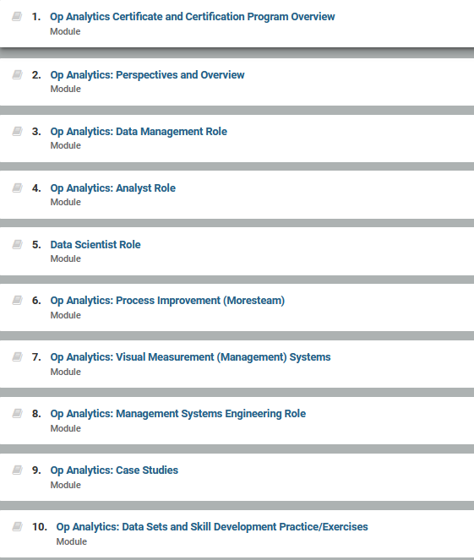
10 fundamental modules make up the certificate program. On-demand Learning Management System. Chat Coaching and periodic ‘huddle’ coaching included. Approximately 120 hours of studying designed to be completed in 6 months or less.

