Slide 1
IISE Global Performance Excellence Webinar Series:
Operational Analytics 401: Reduction to Practice (Best Practice Case Study)
Our Speakers today and our Sponsor:
Michael Caesar
Chief Data & Analytics Officer at University Health Network
https://www.linkedin.com/in/michaelcaesar/
Andre D’Penha
Director, Data Strategy, Governance & Analytics at University Health Network
IISE Coordinator
D. Scott Sink, Ph.D., P.E.
IISE Performance Excellence and Op Analytics Volunteer Lead
Facilitator/Member, CISE
https://www.linkedin.com/in/andredpenha/
14 July 2023

Slide 2
Agenda
11:00-11:05 Scott Tee-up and Intro’s
11:05-11:45 Michael and Andre
11:45-11:55 Integrate Questions from Audience
11:55-12:00 Scott close out and overview what’s ahead in July and August

Slide 3
Housekeeping
1
Thank you for joining us!
We’ll share how to get access to the recording, presentation, YouTube versions and blogs at the end of the webinar. The presentation is available now, use this link to get.. (we’ll post as a chat)
We will field questions as appropriate and time permits. Please use the ‘chat’ function to share your comments and questions.
Follow up questions are welcomed and contact information is provided at the end of the presentation.
For those who value certificates of participation, IISE will be mailing those out the week after the webinar. Be patient and check your clutter and spam folders if you don’t receive one.
2
3
4
5
Thanks to our Sponsor and Partner for investing time, money, energy programming and directing this overall Program for IISE!

Slide 4
Our 2023 Mini-Series’ :
Strategies for Riding the Waves of Disruption
Supply Chain Management 4.0/5.0
Operational Analytics
AI

Slide 5
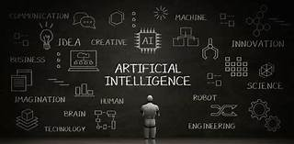
The Purpose of our upcoming AI Miniseries
Sense making in an everchanging World
ISE Perspectives and Points of view on AI

Slide 6
Membership has it’s Privileges….
Look for our Feature Article from our Operational Analytics Mini-Series in August!!!
Aug 2023
April 2023
Dec 2022

Slide 7
100+ Timely Webinars on a full spectrum of Performance Excellence topics with an Integrated Systems Engineering Perspective and Point of View. Available on-demand for IISE members. Clustered into packages of webinars to provide tailored Certificate opportunities for our Members. 1--Operational Excellence 2--Integrated LeanSigma 3--Operational Analytics 4--Change Leadership & Management
Strengthen your Resume and Linkedin Page!!
Use this link to get to IISE’s ‘on-demand’ landing page for these webinars…..
https://www.iise.org/details.aspx?id=46729#analytics

Slide 8
Healthcare and Life Sciences has been a focus over the past couple of years
OSU Med Center Flow Workshop Case Study

Slide 9
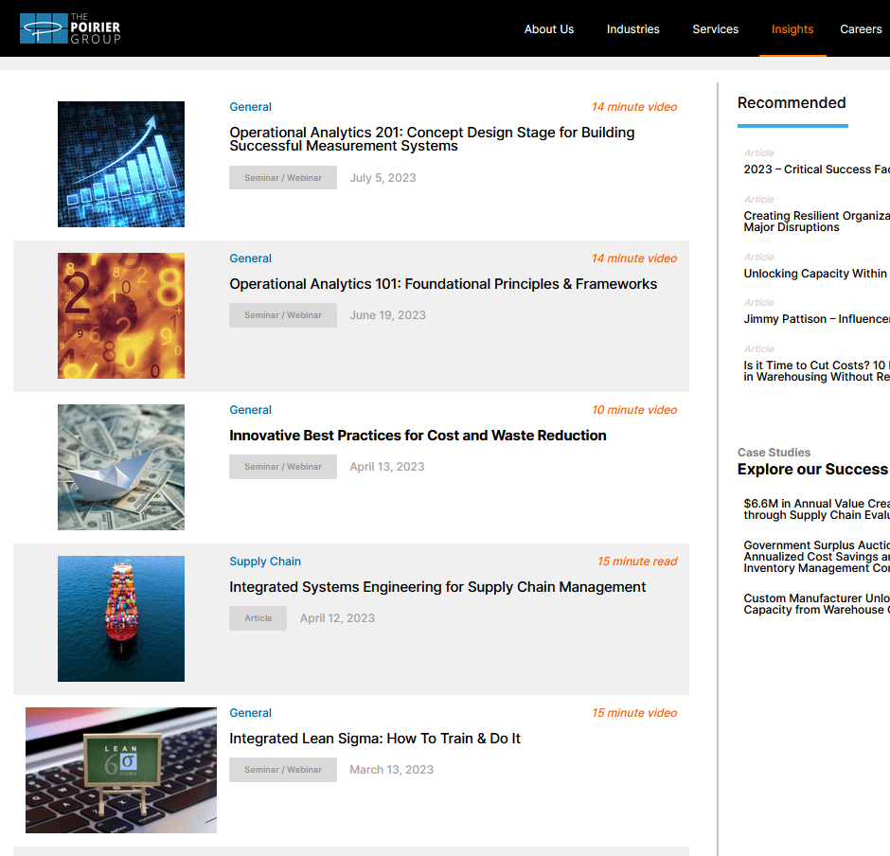
Visit The Poirier Group’s Website to access shorter versions of these Webinars (snippets)
https://www.thepoiriergroup.com/perspectives/
Or go to the TPG YouTube Channel for the short and longer version.
https://www.youtube.com/channel/UCixxhLPZrwdK-DdKYqYZm1A

Slide 10
Operational Analytics Mini-Series
OA 101: Foundations, Principles, Frameworks for Building Improved Management Systems and integrating Operational Analytics
The Management Systems Model
OA 201: Building Improved Operational Analytics Capabilities
The Analytics Triangle
OA 301: Building integrated “B” (PDSA) Systems that systematically drive improvement better and faster
Tiered Huddles, Visible Measurement Systems, etc….
OA 401: Reduction to Practice: Best Practice Case Examples— University Health Network, Toronto
OA 501: Methods and Tools to enable improved Operational Analytics
OA 601: Segue into AI and ML

Slide 11
IISE Best Practice Case Studies in Analytics:
University Health Network—Toronto
JULY 14, 2023

Slide 12
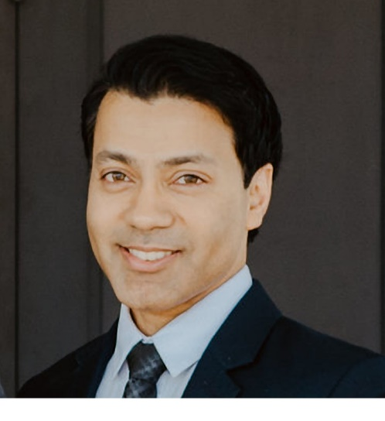
About Us
Michael Caesar
Chief Data & Analytics Officer
André D'Penha
Director, Data Strategy, Governance & Analytics
Michael is the Chief Data & Analytics Officer for University Health Network [UHN] in Toronto as well as Adjunct Faculty with the Institute for Health Policy, Management and Evaluation at the University of Toronto. He brings over 20 years experience supporting and leading organizational change.
Michael has served in several healthcare leadership roles focusing on complex clinical change management, transformation, clinical process improvement and enterprise and regional program management.
André is the Director, Data Strategy, Governance & Analytics for UHN in Toronto, and is responsible for advancing UHN’s data governance maturity and data literacy, as well as accelerating the use of applied analytics to support patient care and operations.
André has 18 years of experience in healthcare, retail, and automotive industries, focusing on process engineering, clinical, quality improvement, analytics, and data governance projects.

Slide 13
Overview of UHN

Slide 14
Providing care to the community for more than 200 years, UHN is a major landmark in Canada’s healthcare system and a teaching hospital of the University of Toronto
About UHN
1,320 Beds
37,996 Inpatients
1,256,363 Outpatient Visits
112,280 ED Visits
$2.8B Revenue
$475M External Research Funding
19,318 Employees
1,690 MDs
2,078 Research Personnel
11,000 Students
10 Clinical Programs
Arthritis (MSK)
Neuroscience
Laboratory Medicine
Medical & Community Care
Cardiac Centre
Cancer Centre
Surgery & Critical Care
Toronto Rehab Institute
Multi Organ Transplant
Medical Imaging
Transforming lives and communities through excellence in
care, discovery and learning
Michael Caesar, Chief Data & Analytics Officer, UHN, 2022

Slide 15
UHN’s Strategic Priorities
UHN’s Strategic Priorities
TeamUHN
Converge care, research & education
Technology & innovation
Canada as a world destination
Invent tomorrow’s care
Michael Caesar, Chief Data & Analytics Officer, UHN, 2022
Data & Analytics

Slide 16
About UHN Data & Analytics
Building Organizational Capabilities
Data Operations
Support manage data stores
Enable access and use of data
Support the organization in understanding ontologies and data definitions
See and understand data quality
Manage the data life-cycle - capture, use, purge
UHN Data & Analytics
seeing, understanding and using data to create a healthier world
Re-engineering decision making
Support decisions & enabling transparency in all that we do
Build and implement new tools (descriptive, diagnostic, predictive, prescriptive)
Data literacy - improve the understanding and use of data
Enable the organization to make better, faster, more accurate decisions
Data Operations
Re-engineer Decision Making
Partners in Change
Partners in change
Understanding of the business (operations & strategy)
Performance improvement - support focused and measurable improvement
Understand, anticipate, interpret & translate business processes
Support the convergence of enterprise and local strategies
Manage risk and highlight opportunities
Key Synergies
Support impactful delivery of value to the health system
Discover, validate, design and deliver opportunities of change
Contextual awareness to ensure successful implementation
Michael Caesar, Chief Data & Analytics Officer, UHN, 2022
Data & Analytics

Slide 17
UHN’s Data & Analytics Strategy
Data-driven decision making enabled across UHN
Liberated data assets for patient care, discovery and learning
Policies built to support and enable strategic pursuits
Strategically aligned enterprise data architecture
Standardized datasets and data management
Protect and unlock data through balanced infrastructure investment
Improved data literacy across UHN (UHN community at large)
Transparency through data in all that we do
Liberated capacity by balancing human-machine automation
Building UHN’s ability to see, understand and use its data to advance patient care, education and research
Empowered Leadership using analytics to drive novel care models
Supported insight and decision making through predictive analytics
Empowered staff building innovative solutions using data
Established partnerships supporting learning and development
Enabled ethical public-private collaboration in the use of data and insight
Michael Caesar, Chief Data & Analytics Officer, UHN, 2022
Data & Analytics

Slide 18
Enabling Insight
VISION
MISSION
To build UHN’s ability to see, understand and use its data to advance patient care, education, and research
Quality & Safety
Care Variation & Utilization
Care Equity & Models of Care
TeamUHN & Workforce
AREAS OF FOCUS
To increase understanding and measurement of care quality and patient harm across UHN and enable focused efforts of improvement
To enable visibility of resource utilization and care variation, identify opportunities for improvement and partner to build efficiencies and eliminate waste
To enable better visibility into UHN marginalized populations and identify and evaluate new models of care
To increase UHN’s insight and enable planning of its workforce, its well-being, and its future
Decision Intelligence
Analytics & Insight
Performance Management Systems
ROADMAP & DELIVERABLES
Dashboards & scorecards through visualization, storytelling tools & automation
Surface improvement opportunities and automate solutions through analytics, modelling, simulation & optimizing
Standard work supporting data exploration, benchmarking, KPI, registries, and improvement
STRATEGIC UNDERPINNINGS
Unified Data Framework
Data & Information Governance
Data & Analytics Literacy
Build Data Operations
Care, Admin, Research & Education
Care, Admin, Research & Education

Slide 19
What is a data-driven organization?
Data Supply Drivers
Data Demand Drivers
Rich Data Sources
• Electronic Health Records • Health Information Exchange (HIE) • Genomic Information Systems • BioRepositories • Benchmarking •
Personalized healthcare
• Shared decision making • Personal ownership of health record • Engagement & persuasion hub •
A Healthcare organization that is data-driven
Continuous Data Streams
• Wearable body sensors • Implantable systems • Point of care testing • smart sensors/bandages • nanotechnology •
Non-traditional care environments
• Reduced hospitalization • Video/tele health • Virtual and augmented reality •
Imbed Data in every decision, interaction & process
Patient Generated
• Personal health applications (apps) • Patient portals • CRM • Patient engagement portfolios •
Predictive medicine & AI enabled care
• Shift from restrictive gatekeeper to coordinator • Rapid diagnosis and treatment • Predictive modelling • Learning health system •
Web and Social media
• Online communities • Public forums •
Smart Machines
• Internet of things • Intelligent processors • Machine to machine • Robotics •
Population health
• Patient stratification • Disease prevention and health promotion • Chronic diseases • Value-based care delivery models •
Quality data
Stewardship
Integrated across care continuum
Use, Access & Sharing
Data Literacy
Performance Operations
• Workflow • Time stamps • Effort • Investment •
Efficiency & Optimization
• Patient flow • Delivery • Efficiency • Cost •
Michael Caesar, Chief Data & Analytics Officer, UHN, 2017
10
Data & Analytics
Notes:
Our collective goal

Slide 20
Why does it
Matter
Personalized healthcare
Predictive medicine & AI
Our aspirations to improve the delivery of care is limited by our ability to see, understand and use data
Population Health
Non-traditional care environments
Data
Fragmented, siloed and quality unknown
Efficiency & Optimization
Analytics
Inability to respond to analytics use cases
Inconsistency
Results vary from different sources
Slow Decisions
Decision cycles limited by access to data
Michael Caesar, Chief Data & Analytics Officer, UHN, 2022
Caesar (2019) https://www.linkedin.com/pulse/future-data-driven-healthcare-we-only-knew-what-know-michael-caesar/
Data & Analytics

Slide 21
It’s More Than Just About Data
DATA
STRUCTURE
GOVERNANCE
ANALYTICS
INSIGHT
CHANGE
VALUE
DATA
PROCESS
The need to connect data to value
Create a deliberate, bi-directional connection between data and value
Link insight and business process understanding to drive change and improvement
Enable deep learning across the organization
Develop data-driven capacity and capabilities
Michael Caesar, Chief Data & Analytics Officer, UHN, 2022
Caesar, et al. 2020. Connecting Data to Value: An Operating Model for Healthcare Advanced Analytics - Healthcare Quarterly
Data & Analytics

Slide 22
Operating Model

Slide 23
The Five Fundamental Pillars For Change At Scale
VISION & LEADERSHIP
Articulate a vision (North Star) of driving business change using data & analytics and provide executive support to motivate and influence the improvement journey
BUSINESS VALUE
Develop an effective strategy to ensure the implementation of targeted use cases to realize business benefits
OPERATING MODEL
Deploy an operating model to better organize data capabilities and develop, deploy, & operate analytics solutions
GOVERNANCE & POLICIES
Establish robust rules and processes to ensure an organizational culture that promotes responsible use of data
TECHNOLOGY
Build data architecture and deploy an analytics platform to scale analytics solutions across the organization

Slide 24
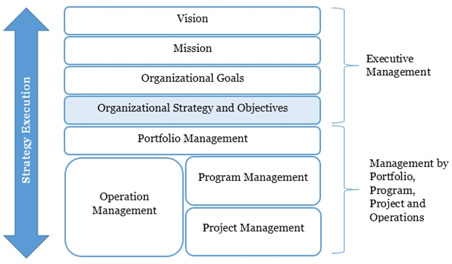
Organizations need a vehicle to execute the strategy
Bi-directional link from strategy to operations
“Run the business - change the business”
Structure to manage the complexity
Structure to promote collaboration (no silos)

Slide 25
Operating Model for Advanced Analytics in Healthcare - OMIX-H
Establish a centre of gravity
Create clear multi-directional connection (North & South, East & West)
Develop capability and capacity
Governance and oversight
Strategic pull and operational responsiveness
Strategy & Relationship Management
Change & Automation
Advanced Analytics & Insight
Analytics Literacy
Data & Information Governance
Data Technology & Operations
Caesar, et al. 2020. Connecting Data to Value: An Operating Model for Healthcare Advanced Analytics - Healthcare Quarterly
Data & Analytics

Slide 26
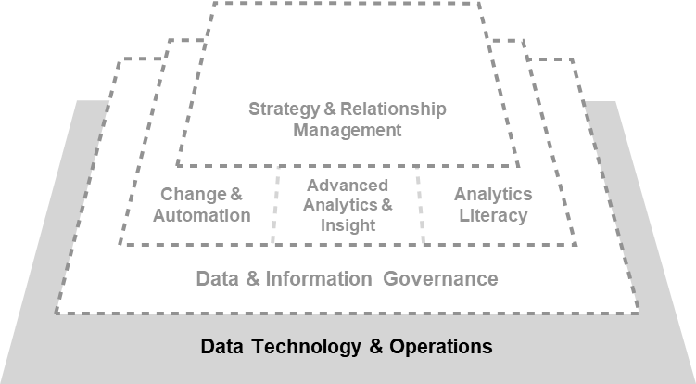
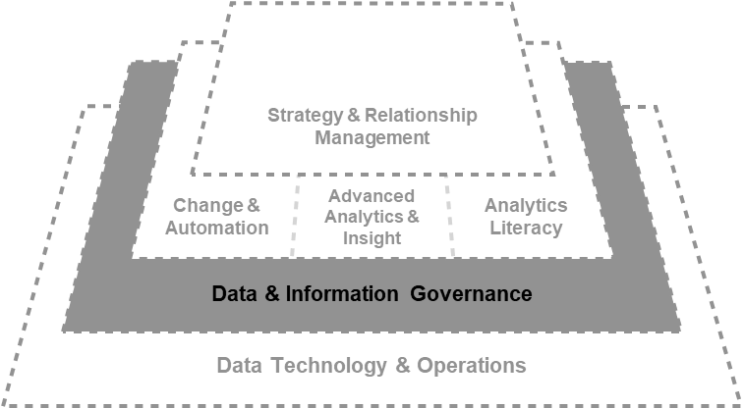
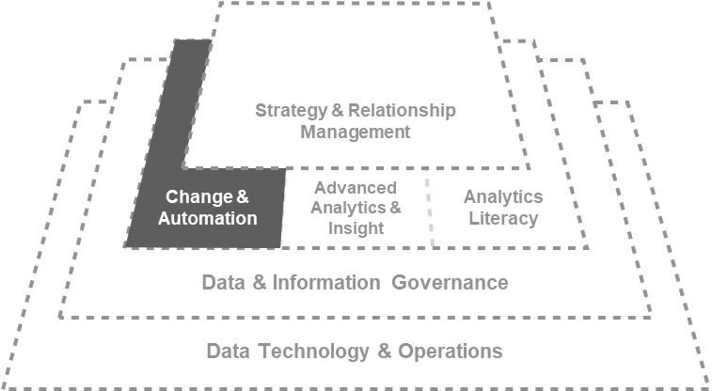
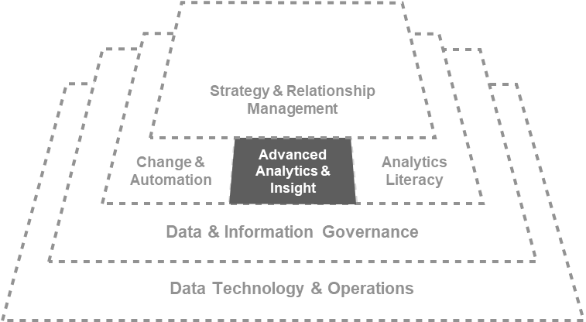
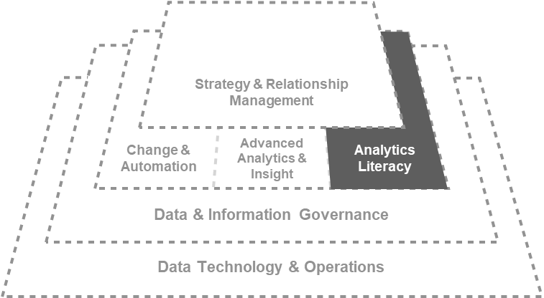
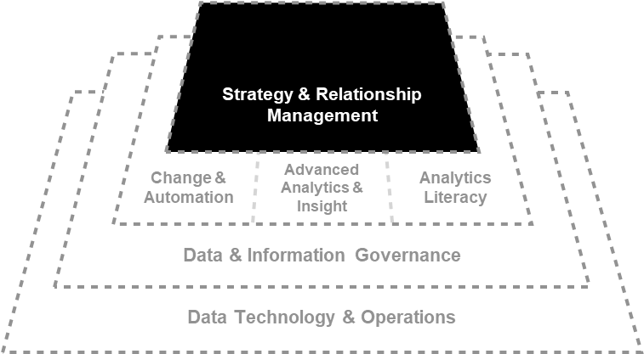
OMIX-H Components
Managing the flow of data and information required to develop analytics solutions
Serve in organizing efforts to manage, protect and enable value from enterprise data assets
Coordinate the implementation of advanced analytics solutions to ensure human and AI systems can work, interact and communicate with each other
Enable explorations insight generation and problem solving using data
Advance the organizations capabilities in understanding data, its collection, management and application
Stimulate, surface and shape the organization’s needs across all domains of the organization
Caesar, et al. 2020. Connecting Data to Value: An Operating Model for Healthcare Advanced Analytics - Healthcare Quarterly
Data & Analytics

Slide 27
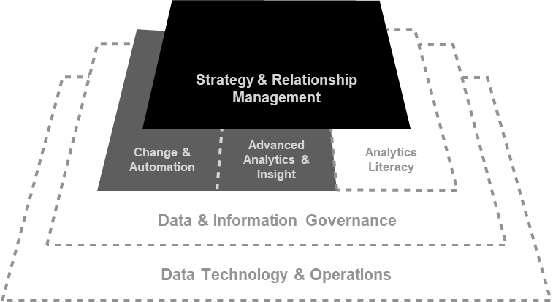
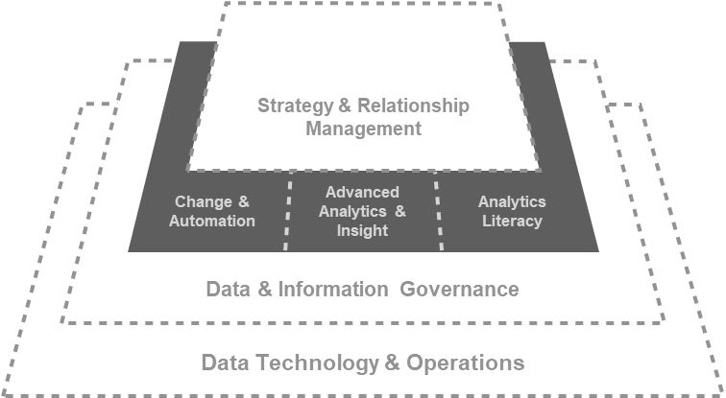
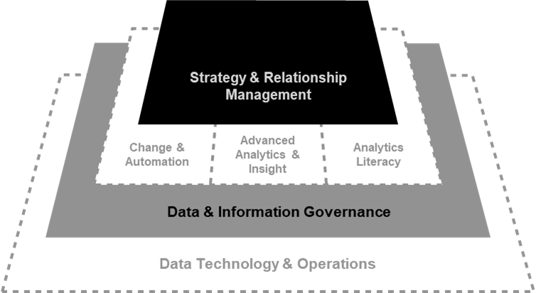
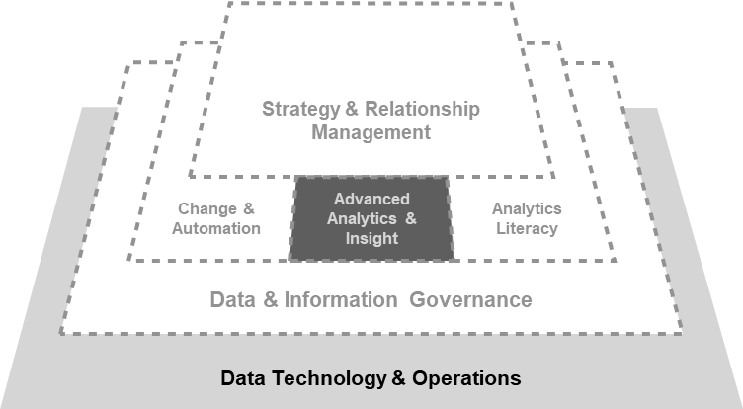
OMIX-H Interactions
PEOPLE/CULTURE & DATA LITERACY
Ensure that organizational culture and people capabilities advance with the introduction of need ways of doing work
PRIORITIZATION & INVESTMENT
Prioritization of advanced analytics or AI projects
RISK TOLERANCE
& STRATEGY
Ensure a balance between risk appetite and strategic pursuits
TECHNOLOGY & BUSINESS OPPORTUNITIES
Understand current and future needs to data technology and help align investment
Caesar, et al. 2020. Connecting Data to Value: An Operating Model for Healthcare Advanced Analytics - Healthcare Quarterly
Data & Analytics

Slide 28
Role Profiles

Slide 29
Decision Support Analyst
Our resident experts in informatics helping UHN understand its data and performance
Role:
Performance data quality, reporting and analytics for clinical and management teams
Skills:
Epic Cogito reporting, business intelligence, communication, and statistical analysis
Medical terminology and informatics proficiency
Database tools/programs (e.g. Crystal Reports, Power BI, SAS and Python)
Large healthcare data sets
Value proposition:
Provide accurate information and thoughtful insights on hospital performance to support operational and strategic evidence-based decision-making
Recommend innovative ways to improve reporting process efficiency and data quality
Example Contributions:
Stroke Accreditation
Blood Group Confirmation to ensure patient safety and optimal delivery of blood resources

Slide 30
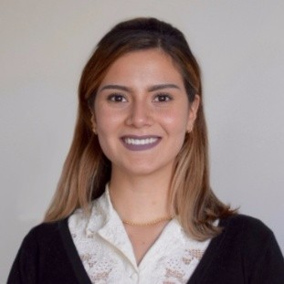
Analytics Consultant
Using data to solve problems and generate insight
Role:
Utilize analytics and data to understand and address healthcare challenges
Skills:
Simulation, predictive analytics, operations research, project management, and change management
Value proposition:
Leverage UHN data assets to develop innovative analytics solutions that improve the delivery of care and operations
Example Contributions:
Toronto General Hospital Simulation Model [inform medium and long-term capacity planning]
Primary Care Provider Data Visualization [understand patient/provider care in the community]
Emergency Department Predictive Model [forecast patient arrivals to inform staffing decisions]
Eating Disorders Program Model [understand available capacity and reduce patient wait times]

Slide 31
Data Storyteller
Helping UHN connect to its data, understand it, and take action
Role:
Convert business problems into decision intelligence solutions using data-driven visual stories to drive decision-making
Skills:
Data visualization, development methodologies, information architecture, data analysis, user interface design, agile product ownership, and change management
Value proposition:
Communicating complex data through storytelling to support patients and staff in making critical decisions
Example Contributions:
UHN Corporate Scorecard [inform Executive Leadership and Board on performance against North Star Indicators]
Patient facing Emergency Department (ED) wait times tool [inform patients and staff of expected wait to see a provider]
Patient Experience dashboard [understand and improve how patients’ experience care at UHN]
COVID-19 vaccine registry dashboard and portal [identify and prioritize eligible groups for vaccination]

Slide 32
Example Use Cases

Slide 33
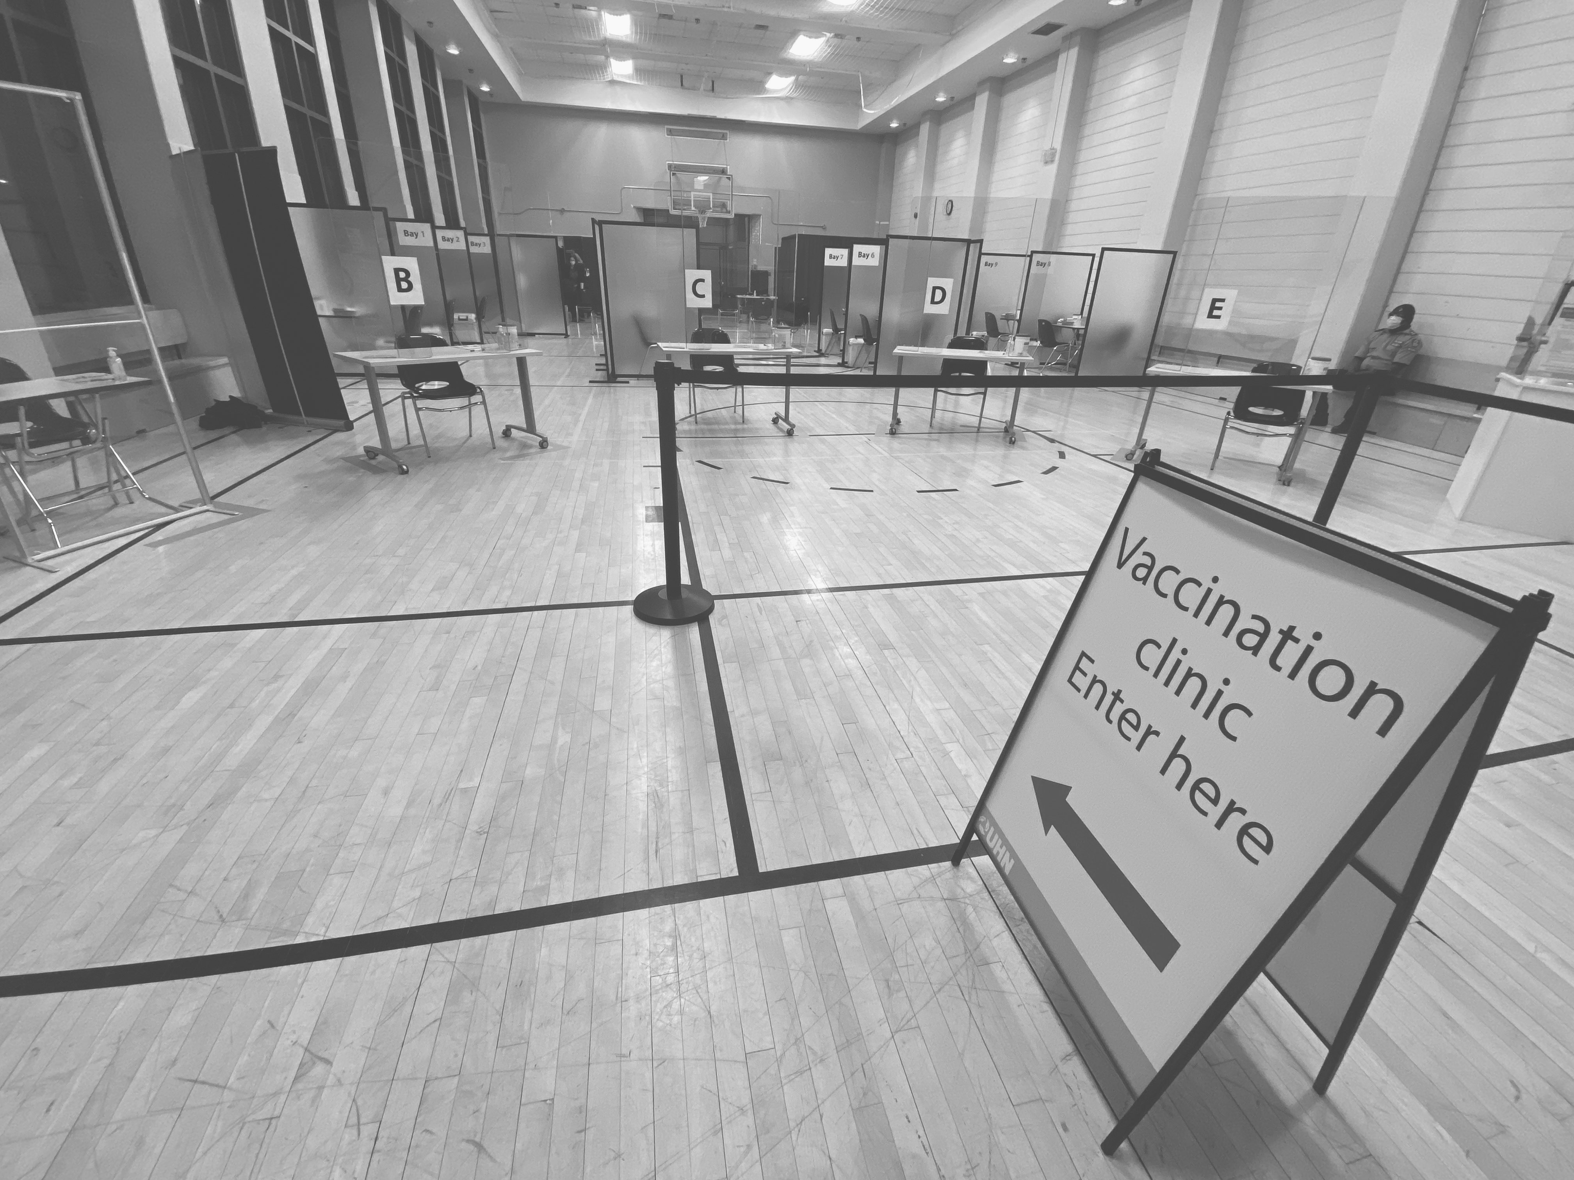
Canada’s 1ST COVID-19 Vaccine Clinic
Inform Pilot & Long-term Vaccine Administration Decisions using Queueing Theory, Simulation Modelling & Clinic Optimization
Data & Analytics

Slide 34
Inpatient Bed Capacity Planning
Inform Medium & Long-term Bed Capacity Planning through scenario testing with a General Hospital Simulation Model
Main Questions Answered:
How do changes in surgical throughput impact bed utilization and surgical cancellations?
What level of bed capacity is needed to maintain increased surgical throughput?
Data & Analytics

Slide 35
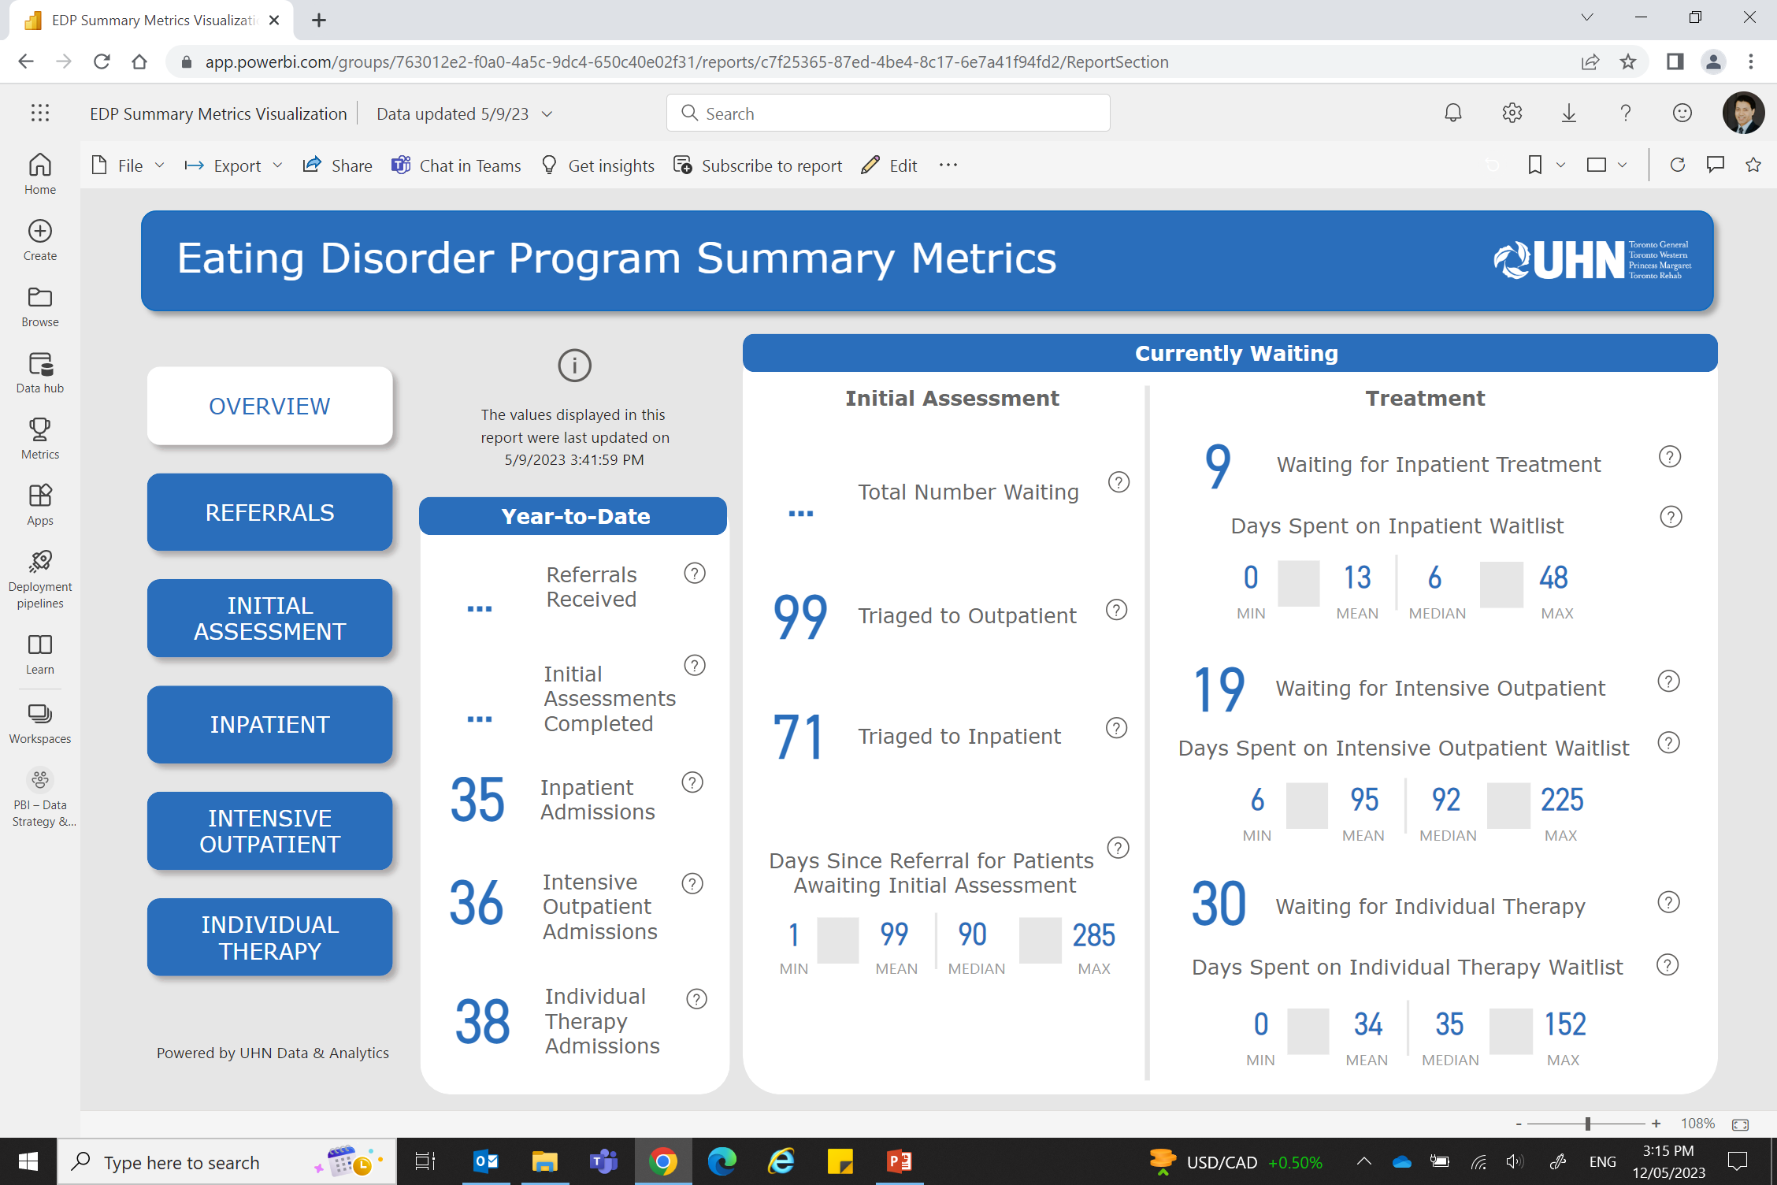
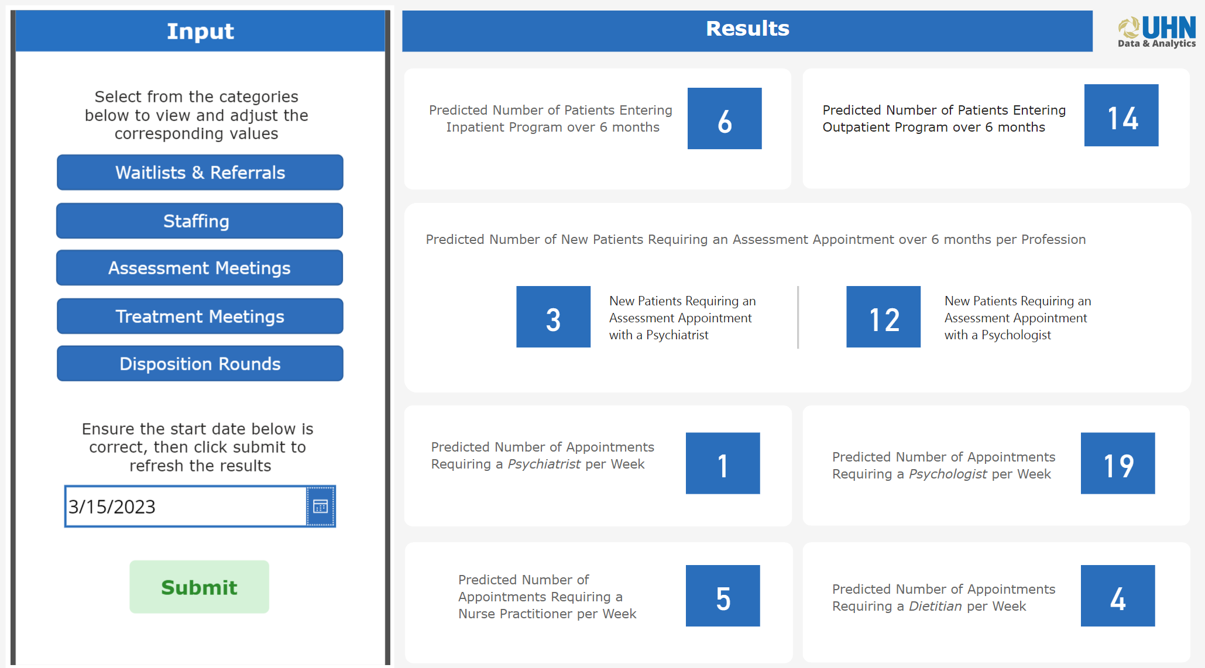
Eating Disorders Program Optimization
Optimize intake processes and reduce the Program waitlist backlog
RESOURCE UTILIZATION MODEL
Test various staffing scenarios and their impact on referral backlog
Predict referrals demand for the next 6 months
SUMMARY METRICS DASHBOARD
Visualize referrals and waitlist metrics for Program performance insights
Compare current wait times against historical performance and Program targets
Data & Analytics

Slide 36
Our cultural transformation beyond the data & analytics
Enabling transformation in healthcare
Health Outcomes
Adaptive Processes
Patient & Provider Experience
Decision Science
Data Fidelity
Risk Tolerance
Data Literacy
How are we going to introduce impactful real time information and insight to support and automate decision-making and change behaviour?
How do we balance investment in governance, processes & policies to ensure data is of highest fidelity and quality - without creating barriers for data access, use, and sharing?
New paradigms of how work gets done will be introduced - how do we surface, assess and challenge our risk tolerance?
Our collective ability to become more data-driven and translate insight into impact will be one of the largest barriers to overcome
University Health Network - Not for Distribution

Slide 37
THANK YOU!

Slide 38
Questions for a short dialogue
How long have you been at this ‘transformation’, migration towards a data/fact based organization?
At a high level, how has your ‘migration strategy’ evolved, changed over time?
What advice would you give to an organization (regardless of industry) in terms of getting started, developing a strategy?
You mentioned that you’ve staffed your team with a number of people from industries who you felt were ‘down the road’ with Organizational and Operational Excellence. Has that worked for you?
What do you see ahead, next five years in the domain of Operational Analytics?
What do you see ahead, next five years relative to Health Care Organizational and Operational Excellence?

Slide 39
And, Just Ahead…..
July and August Offerings for you..
Our final OA Webinar in the Mini-Series:
18 July—Operational Analytics 301
Register for Operational Analytics 301
3 Aug—Op Analytics 501—Tools and Segue to AI/ML (TBA)
Capstoned by a Feature Article in the ISE Magazine in August.
Aug, Sept, Oct Sneak Preview
An ‘AI’ Miniseries
10 August: AI 101—Foundations, Definitions, Possibilities, ISE role
September--Our Annual Final Four Capstone Senior Design Presentations
19 October—IISE Final Four Outstanding Service Systems Engineering Presentations (sponsored by Penn State IME)

Slide 40
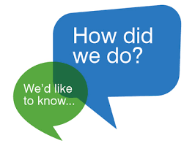
Complete a Short Survey for us?
Your Feedback is Important:
A short survey will be available to you as just prior to leaving the webinar, we’d appreciate your input.
Reach out if you have questions or other needs:
James Swisher jswisher@iise.org
Scott Sink ssink@jumpcurves.com

Slide 41
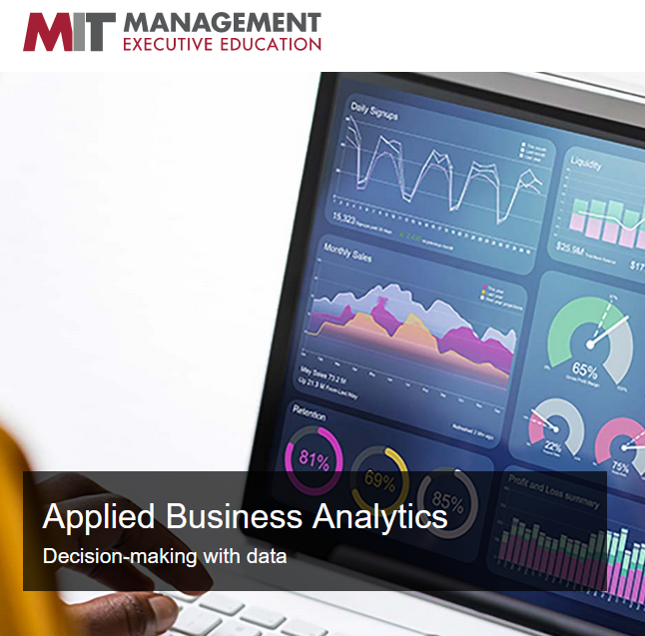
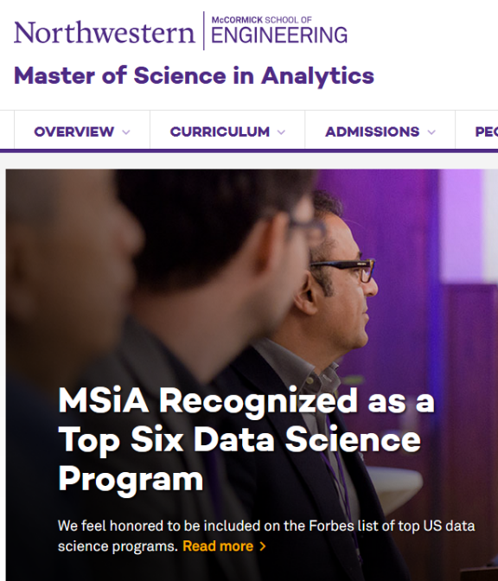
Op Analytics Development Options
120 hours ++, $400 students + $250 for certification
$475/675 member/non-member + $550 for the certification
4 days to 6 mos. $600-$5,000
1-2 yrs, $50-100k
Time/
Cost
On-Line, Virtual
On campus or Hybrid MS Programs
Hybrid/ Blended Model
https://careerfoundry.com/en/blog/data-analytics/best-data-analytics-certification-programs/

Slide 42
Op Analytics represents huge opportunity for ISE’s
In Partnership with:
The Poirier Group
Moresteam University
Delivered Uniquely:
IISE Digital Op Ex ‘Mall and Stores’
10+ Video Modules for easy, self-paced consumption/learning
‘Chat’ Support with Coaches
Periodic Huddles for virtual coaching
Certificate requires an on-line final exam
Certification requires the Certificate plus a reduction to practice, proof of skill project
Module 1: OA Thought Leader Perspectives
Module 2: Operational Analytics Perspectives, Points of View and Foundational Principles and Methods and Models
Module 3: Operational Analytics: The Foundational Data Management Role
Module 4: Operational Analytics: The Analyst, Decision/Action Support Role
Module 5: Data Sciences and The New Industrial and Systems Engineering
Module 6: Operational Analytics: The Evaluation Role
Module 7: Operational Analytics—Visual Measurement/Management Systems (Parts I, II, III)
Module 8: Operational Analytics: Putting it All Together: Case Studies
Module 9: The Role of Data and Information (Engineered Management Systems) in Periods of Major Disruption, Reducing the Latencies
Module 10: Creating Cultures that Support Full Potential Performance/Operational Excellence

Slide 43
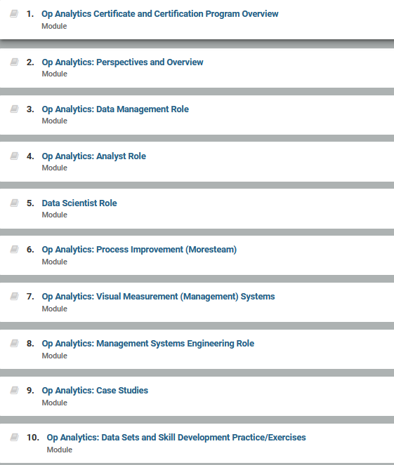
10 fundamental modules make up the certificate program. On-demand Learning Management System. Chat Coaching and periodic ‘huddle’ coaching included. Approximately 120 hours of studying designed to be completed in 6 months or less.

