Slide 1
IISE Global Performance Excellence Webinar Series:
Operational Analytics 101: Foundations for Great Performance Measurement Systems
Our Speaker today and our Sponsor:
D. Scott Sink, Ph.D., P.E.
Senior Advisor
The Poirier Group
IISE Coordinator
Scott Sink Linkedin page
D. Scott Sink
IISE Performance Excellence and Op Analytics Volunteer Lead
Facilitator/Member, CISE
12 June 2023

Slide 2
Agenda
11:30-11:40 Scott to ‘tee-up’ the session
11:40-12:10 Operational Analytics Foundations
12:10-12:20 Respond to questions from audience
12:20-12:30 Scott close out and overview what’s ahead in June and July

Slide 3
Data and Experience Foundation
First book written, “Productivity Management: Planning, Measurement and Evaluation, Control and Improvement” John Wiley, 1985
Based on Dissertation and Consulting and Research completed 1976-1985
Teaching ‘Performance Measurement, Management Systems Engineering, Integrated LeanSigma, Operational Analytics 1978-1997 and then 2007-2020. (Ok State, Va Tech, Ohio State)
VP Business Process Improvement 2000-2007, leading Op Ex.
Practicing—directed, coached over 250 business process improvement projects from 2007-2020 in wide spectrum of industries and for wide range of types of performance problems.
Still learning more every day.

Slide 4
Key points
Good analytics come from good context understanding, use case clarity, good problem statements, clear understanding of DONE;
Some people have every skill – business acumen, data management, analytics understanding – to perform a good Operational Analytics – but it tends to result in a slow ‘craft’ development process for most;
Investment in the right data foundation has a positive ROI, as analysts move faster when they trust the data – results in faster results;
Good data visualizations can tell the right story quickly, because people are predisposed to believe what they see in a chart;
There is very positive ROI in getting Operational Analytics well designed and developed– small analytics teams can wield disproportionate influence on the bottom line;
Good Operational Analytics provokes more timely decisions and actions – indeed, in most organizational systems, simple and persuasive/influential beats complex/ambiguous every time.

Slide 5
Operational Analytics—Opportunity Framing
Vague, poorly formed idea of the problem, no ‘good’ diagnosis, hence no ‘good’ strategy
Clear, Succinct Problem Statement, Vision, Strategic Pathway, Migration Plan
We should be measuring more…
We’re data rich and information poor
We’re data poor
Measurement matters
Jump on the Analytics bandwagon
Improve Accountability
Measure what matters!!
Balanced Scorecards
KPI’s
Analytics
Big Data
ERP’s
Power BI, Tableau, ChatGPT, AI…….
There is a logical strategy path, roadmap, migration plan to follow to build tiered visible measurement systems in our organization.
Learn the strategy path and follow it.
Good Strategy vs Bad Strategy….

Slide 6
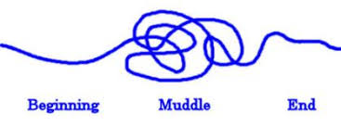
Operational Analytics—Opportunity Framing
Avoid the Muddle!

Slide 7
Logic for the OA Foundations
OA 101: Foundations for Building Performance Measurement, Evaluation, Improvement Systems
Systems Thinking and Process Breakdown Structure
The ‘Management Systems Model’ (Management Systems Engineering)
Management Systems Analysis (Value Streams and Control Points)
Users and Use Cases
Decision-Action (Study/Adjust) Requirements
Information Requirements & Portrayal, Perception, Insights to Actions
Data Requirements
Data Management Requirements
Data Analytics Requirements
Visualization Requirements
Getting all the System Components in Place to ensure ‘End Game’ Achieved

Slide 8
Logic for the Mini-Series and the Certification Program
OA 101: DEFINE--Foundations for Building Performance Measurement, Evaluation, Improvement Systems
Systems Thinking and Process Breakdown Structure
The ‘Management Systems Model’ (Management Systems Engineering)
OA 201: CONCEPT DESIGN--
The ‘Operational Analytics’ ‘Triangle’ Model
The ‘Questions’, where do we start with Op Analytics Development Projects?
Picking the right improvement projects, Portfolio Management, Using Op Analytics as a tool for picking the right improvement projects (how Op Analytics helps with P and S)
Seeing, understanding Op Analytics as an integral component of the PDSA, System and Process Improvement Methodology and work
The Data Design, Development, Management Role
Concepts to help with data modeling, data ‘base’ development
Creating the foundation upon which Analytics Tools sit and can be fully utilized
The Data to Information to Insights Role

Slide 9
Logic for the Mini-Series and the Certification Program (DCDOV)
OA 101: DEFINE--Foundations for Building Performance Measurement, Evaluation, Improvement Systems
OA 201: CONCEPT DESIGN—The Data Management and Analyst Roles and Methodology
OA 301: DETAILED DESIGN AND DEVELOPMENT—Developing Visible Measurement and Management Systems that ‘catalyze’ knowing what to improve and how things are improving over time.
Defining ‘Visibility’, The Power of Visible Measurement, How they support “Good Strategy”
Building Scorecards and Dashboards
Deploying them into Tiered Huddle Systems (as example)
OA 401: BEST PRACTICES (Case Studies)
University Health Network, Toronto, Chief Data and Analytics Officer
OA 501 and 601 (on drawing board)
Advanced Tools to support best in class Operational Analytics

Slide 10
You can’t do ‘good’ Analytics work and not be a good Systems Thinker

Slide 11
ISE’s Create Value by Integrating People,
Strategy, Process and Technology
Operational Analytics is the ‘central nervous system and brain’ behind this integration
Enhancing the way you think and plan
Strategy
Organizational
Alignment
Changing the way we exchange value with our employees and manage our culture.
Speed of Trust
Flow
What we do and how
People
Performance
Excellence
Process
we do what we do.
Tech Acceleration
The Analyst Role is a rapidly growing and critical to success function in Op Excellence.
Technology
Leveraging hyper-connectivity and the full power of IT Enablement
4

Slide 12
Operational Analytics Begins with the End in Mind End Game: Grow Enterprise Value

Slide 13
END GAME: Grow Enterprise Value
POSITIONING STRATEGY
VALUE EXCHANGE
OPTIMIZATION
OPERATIONAL
EXCELLENCE
25x
50x
10x
1x
Improve Positioning via..
Geographic Coverage / Offerings Provided / Served Segments / Branding/ Imaging, etc.
Managing the Exchange of Value
With Stakeholders
Altering the Give/Get,
Responding to unmet and unfulfilled needs, QFD, Innovation, Rebalancing Segment
Investment
Improve Quality, Efficiency,
Productivity, Innovation, Engagement, Quality of Work life, Sustainability
Apply principles and methods of ISE and ILSS
The Domain of ISE and Operational Analytics is very broad today
Notes:
Notes:

Slide 14
Succeeding at Operational Excellence and Analytics—why it’s a big deal
$60
A Transformation that Dave played an integral role in…
Built to Last Data
$6

Slide 15
Context – The Purpose of Operational Analytics, Analysts
Facilitate & Enable the creation of solutions
that enable
better decisions faster and then drive actions, improvement implementation, faster and then drive benefits realization faster (desired and positive outcomes) and then grow Enterprise Value (system, process, business value creation).

Slide 16
Logic for the OA Foundations
OA 101: Foundations for Building Performance Measurement, Evaluation, Improvement Systems
Systems Thinking and Process Breakdown Structure
The ‘Management Systems Model’ (Management Systems Engineering)
Management Systems Analysis (Value Streams and Control Points)
Users and Use Cases
Decision-Action (Study/Adjust) Requirements
Information Requirements & Portrayal, Perception, Insights to Actions
Data Requirements
Data Management Requirements
Data Analytics Requirements
Visualization Requirements
Getting all the System Components in Place to ensure ‘End Game’ Achieved

Slide 17
Fundamental Questions
In the pursuit of ‘full potential performance’ in your organization, there are some very basic, fundamental questions that must be answered in the context of Organizational Strategy.
What are the right systems, sub-systems, business processes, processes to focus on? What is our optimal portfolio? What aligns best to our ‘Good Strategy’.
Lots of ways to create the right portfolio (e.g. Theory of Constraints, Pain Point Analysis, Value Stream Analytics to name a few)
How does the ‘focal’ system/process work?
How does it perform (the focus of Operational Analytics)
How do we best improve performance as we’ve operationally defined it? (e.g. mAIc)
Is Enterprise Value Growing? How do we know?

Slide 18
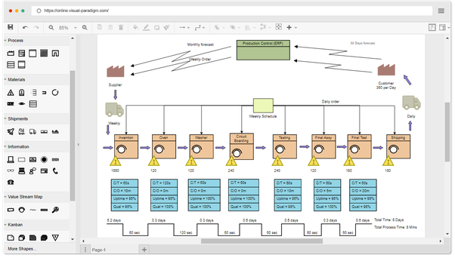
The Management Systems Model—who Manages, what’s managed, how we manage
Leadership & management team
(wisdom application, data/facts to information conversion process)
Information perception/ understanding/ insights
Information portrayal
Data management and Operational Analytics
Decisions
Data entry
Actions
Data capture
Upstream Systems and Inputs:
Suppliers & customer orders
The Business Processes/Value Streams
Downstream Systems and Outputs:
Orders Fulfilled

Slide 19
The Organizational System—What’s being Managed
An Extended Enterprise
An Org Unit
An Extended Value Stream
A Value Stream or Business Process
An embedded Value Stream or Process
A sub-process
Upstream Systems and Inputs:
Suppliers & customer orders
The Business Processes/Value Streams
Downstream Systems and Outputs:
Orders Fulfilled

Slide 20
Methods, Tools to use
SIPOC
End2End Value Stream Mapping
Business Process Breakdown Structure
IDEF
Observe, walk the process, structured interviews
Butcher Block or Miro the Value Stream/Swim Lane
“Smart” Visio, use layering to add or take away detail, zoom in and zoom out capability

Slide 21
Pre-Match Team
Match Support Team
DEMAND
Young People Ready for Life
Apply, Nominate, referred from Schools, mentees, BB’s/BB’s, Churches, etc.
Profile Created
Training
.5
Shane—Team Lead
“Ready” Mentee
Enrollment and Assessment team
2 yrs
Close Match
Young People with 3-5 Adv Childhood Exp. (ACE’s)
1
2
3
Matching Process
Case Worker, Mentor, Mentee
Asset (40) Assessment
3-12
Match Support Team
Match Closure Process
SUPPLY
Profile Created
Refer, Nominate, Apply, Volunteer
.5
To Post Development Phase Engagement
Process
Enrollment and Assessment team
Training
“Ready” Mentor
Development and Evaluation Process
Mentors Willing to Serve
Capability Assessment
Marketing and Communications Team
CRM System
Razor’s Edge (Fund Raising and Donor Mgmt)
HRIS (just getting)
Finance and Accounting

Slide 22
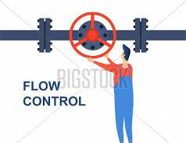
Mentor Application Kanban
Application Processed
Assessment Completed
Training Complete
Evaluation Complete
Applications Processed
[23/ 20]
Assessment Complete
[15/ 20]
Evaluation Complete
[18 / 20]
Training Completed
[26/ 20]
Shape Demand
20-40
Successful launch meetings
Successful launch meetings
IN-FLIGHT PAIRS 1-10
Mentee Application Kanban
Matches Completed
[23/ 20]
Application Processed
Assessment Completed
Training Complete [27 / 50]
20-40
Applications Processed
[31/ 20]
Assessment Complete
[12/ 20]
Training Completed
[24/ 20]

Slide 23
TPG utilized (compliments of Moresteam) Process Playground to create a simulation model for the front end and back-end of the Value Stream.
The model is in validation stages but just doing this significantly improved our ability to understand the system (more than just doing a value stream map).
We will be using the model to confirm our engineered forecasts of solution element impact on LT and Capacity.

Slide 24
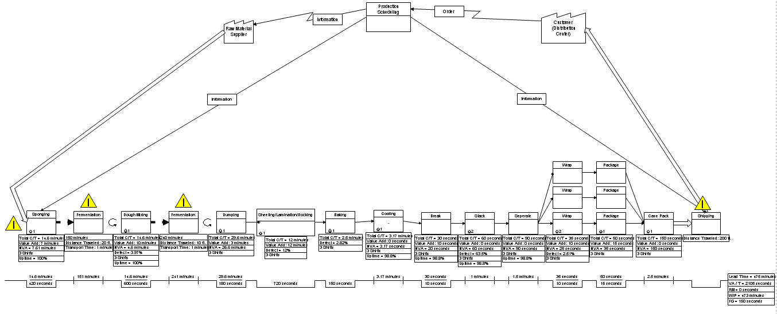
Zoom In: Saltine Line Control Points
3rd Floor
Waste = 12.77%
(production)
4th Floor
Waste = 1.66% (production)
MIXING
Waste = 3.97%
(0.56% production)
SHEET ROLLING
Waste = 12.01%
(1.70% production)
STACKING
Waste = 63.49%
(9.00% production)
BAKING
Waste = 2.82%
(0.40 % production)
WRAPPING
Waste = 17.71%
(2.51 % production)
This problem is nothing new and has actually been the focus of prior improvement projects.
We will take a look at 2 project that have sought to reduce the process variability and in turn, reduce waste.
Notes:
From observational study (sample size, power of sample) →

Slide 25
Enterprise Value Creation for BBBST
By helping them ‘Learn to See and Understand’ with simple value stream maps, the cross-functional team understood where the ‘constraints’ were.
By introducing the concept of ‘flow’ and getting the ‘buffers’ (good thing) and ‘bottlenecks’ (bad thing) right, adjusted properly they increased the ‘Primary Y’, Served Mentees, by 30% with no additional staffing, all caused by process improvement and a Visible Measurement System and Huddles and some great leadership.
Lead time to a ‘match’ and initial meeting came down from 24 months to under 12 and is still improving. (target is 4 months)
Not an overly complex system but the principles, methods, and tools were verified and are an example I think you all can relate to.

Slide 26
The Management Systems Model—who Manages and how we provide better Decision-Action/Study-Adjust support
Leadership & management team
(wisdom application, data/facts to information conversion process)
Who Leads, Manages
The Decision Maker
The Team of people accountable for the ‘system’ being managed
What are their needs and requirements?
What’s their Strategy and Plan and how does this initiative fit?
Decisions
Actions
Upstream Systems and Inputs:
Suppliers & customer orders
The Business Processes/Value Streams
Downstream Systems and Outputs:
Orders Fulfilled

Slide 27
Need to understand…
Who are the key players
Executive Sponsors
Value Stream Owner
Process Owners
What are the R2A2s (roles, responsibilities, accountabilities, authorities)?
What are the ‘teams’ and individuals on the ‘team’ information requirements (what they need/want to know, how they prefer to see ‘information’).
What’s holding them back from making more timely, better adjustments that will improve performance, continue to drive system and process, value streams towards more optimal levels of performance.
What would they like to know that they don’t know, what questions would they like to have answered better, easier, faster?
What they articulate, are conscious about AND also what you, as an ISE know they need to know to optimize flow, performance, reduce waste, etc. Benchmarking can help!!!
What’s the ‘strategy’, what is the future state and what’s the migration plan and then how do we measure what matters!!!

Slide 28
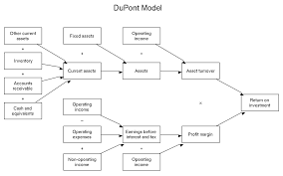
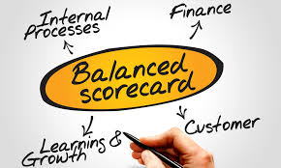
Lots of versions of Balance Scorecard

Slide 29
Another tact on ‘Balanced Scorecards’ (Instrument Panel in Cockpit)
HUD: Effectiveness—what are the right things to DO
(Start’s & Stop’s)
Our Future State Vision
HUD: Effectiveness—What are the right things to DO
(Continues)
Bank 0: Enterprise Value
Bank 1: Profitability/Budgetability
Bank 3:
Innovation Lever—Rate of Improvement
Bank 4:
Productivity
Bank 2:
Efficiency—Resource Utilization, Optimization
Bank 5:
Quality₁
Bank 5:
Quality₂
Bank 5:
Quality₃
Bank 5:
Quality₄
Bank 5:
Quality₅
Bank 4:
Quality of Work Life/Culture

Slide 30
Methods and Tools
‘ERP’ with PowerBI sitting ‘on top’ with Banks of Scorecards & Dashboards sitting in Sharepoint with Tiered Huddles that engage for PDSA
Chartbooks by ‘unit’ with periodic reviews of performance against ‘spec limits’
Chart owners to ensure ‘dial’s’ on instrument panels/banks are sustained, fresh, high quality, creating insights and supporting decisions-actions-adjustments.
Control Point Scorecards/Dashboards—a control point is a spot in the process where we do or should capture data and we do or should make adjustments to how we manage things at that spot. Creating visibility for Control Point performance is a great way to apply analytics.
What are some of the things you are doing?

Slide 31
The Management Systems Model—information requires data, the data management role
Leadership & management team
(wisdom application, data/facts to information conversion process)
Information perception/ understanding/ insights
Information portrayal
Data management and Operational Analytics
Data Organization
Decisions
Data entry
Actions
Data capture
Upstream Systems and Inputs:
Suppliers & customer orders
The Business Processes/Value Streams
Downstream Systems and Outputs:
Orders Fulfilled

Slide 32
The Simplest Causal Model—your data model essentially
Y’s are the effects of interest
X’s are the causal variable of interest that we have data for
U’s are one or more of the unknown or unmeasured variables
x₁
Y₁
Y_{n}
x_{n}
U₁
U_{n}

Slide 33
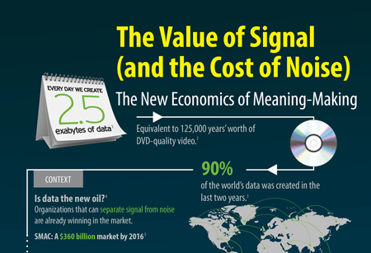
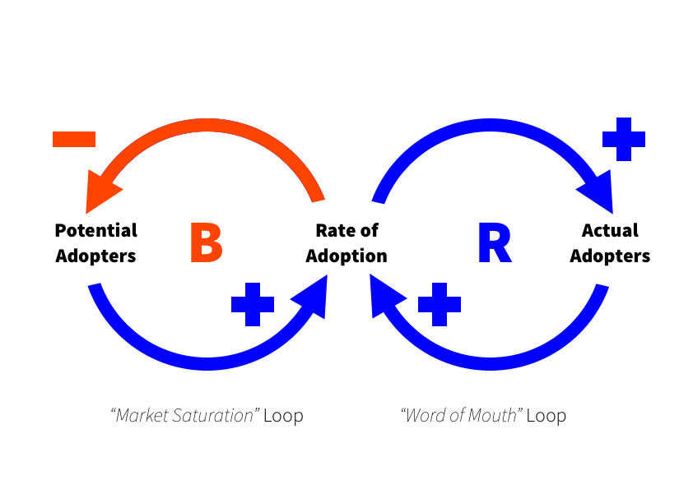
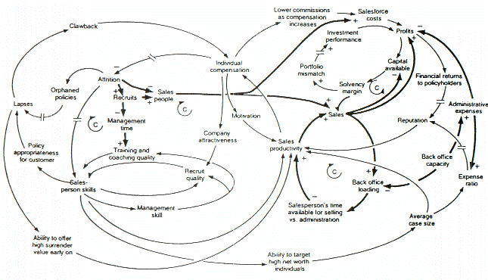
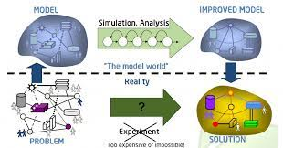

Slide 34
Another take on Systems Thinking. Sometimes organizations and individuals need help integrating Triple and Double loop learning with Good PDSA (are we doing things right?)

Slide 35
Moving from Big Data to Operational Analytics
Unknown, Unmeasured, Unthought about Data
Identify and figure out how to get

Slide 36
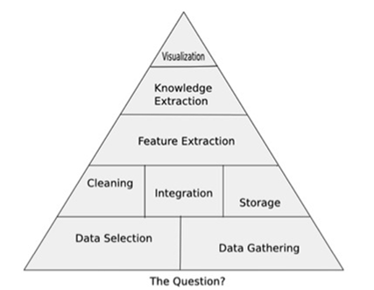
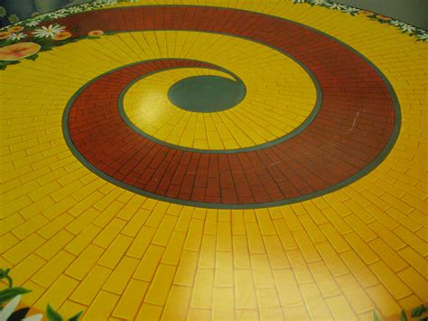
Introducing the OA Triangle Model
The Basic Roadmap for the OA Triangle
“Above the line” analyst role
What are the fundamental Questions that have to be answered?
What data elements do those questions require?
Organize the data and facts and then export to your analytics app.
Extract features from data through integration and manipulation of data that move us closer to answers. (torture the data)
Apply business acumen to data & analyses – create new knowledge
Apply data visualization techniques to aid in telling the right story – as in life, so in business: the best story wins …
Foundational data role
What do we need to know in order to achieve the performance objectives—what are the questions we have to answer?
Architect/Create the Measurement and Analytics Plan (Data Model included)
Select and gather data from many sources, preferably through automated extract, transfer, & load (ET&L) process
Create (observation, interviews, etc.) any data elements that don’t exist (ISE Measurement)
Assure data are cleaned & ready for analysts or you to use – data quality monitors
Assure data are integrated & can be joined with other data – think LEGOs
Assure data storage is high reliability & user-friendly – SSAS cubes, databases
Integration and organization of foundational data elements as well as derivative data and other key metrics of interest
Follow the ‘yellow-brick’ road
Most ISE/ILSS Process Improvement Projects require that the ISE/Belt do both roles, certification requires that
Data is almost never stored in a common place and are not trusted nor available
the current state process in many large organizations splits data and analytics
Data are stored in a common place, and are trusted and available

Slide 37
Zooming in on the Bottom Half
The Basic Roadmap for the OA Triangle
Foundational data role
What do we need to know in order to achieve the performance objectives—what are the questions we have to answer?
Architect/Create the Measurement and Analytics Plan (Data Model included)
Select and gather data from many sources, preferably through automated extract, transfer, & load (ET&L) process
Create (observation, interviews, etc.) any data elements that don’t exist (ISE Measurement)
Assure data are cleaned & ready for analysts or you to use – data quality monitors
Assure data are integrated & can be joined with other data – think LEGOs
Assure data storage is high reliability & user-friendly – SSAS cubes, databases
Integration and organization of foundational data elements as well as derivative data and other key metrics of interest
Follow the ‘yellow-brick’ road
Most ISE/ILSS Process Improvement Projects require that the ISE/Belt do both roles, certification requires that
Data is almost never stored in a common place and are not trusted nor available
the current state process in many large organizations splits data and analytics
Data are stored in a common place, and are trusted and available

Slide 38
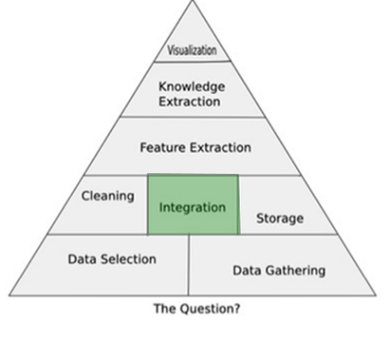
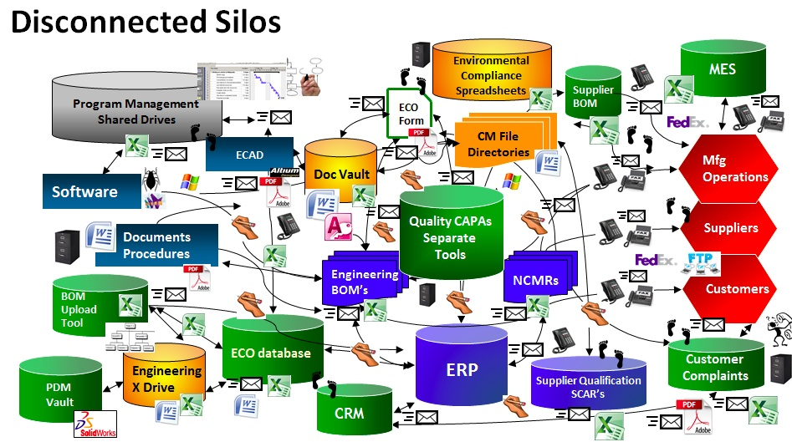
Data Integration – Challenges, Advice, Examples

Slide 39
Example of data integration—hard work but rewards are worth it

Slide 41
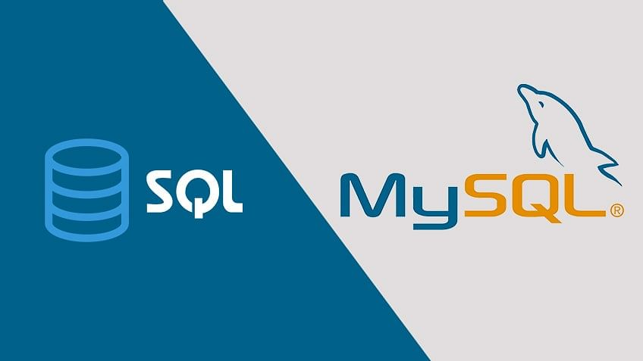
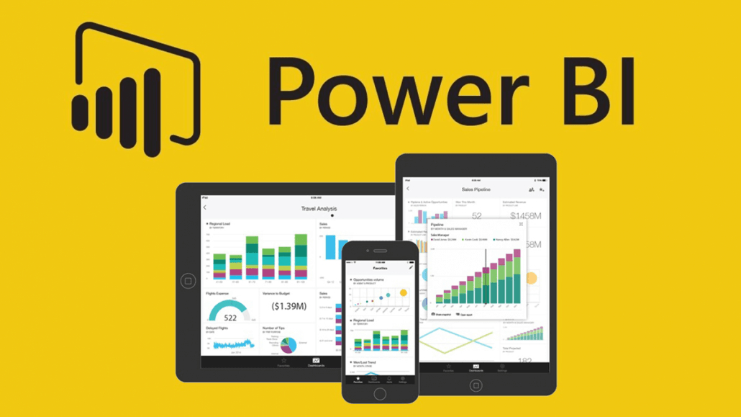
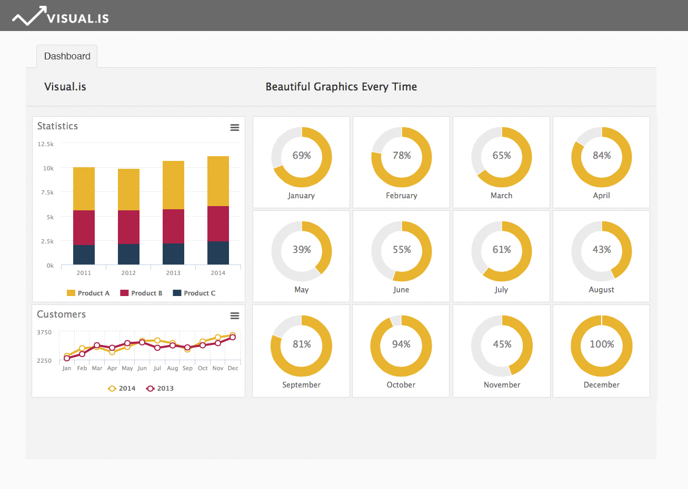
CONCEPT

Slide 42
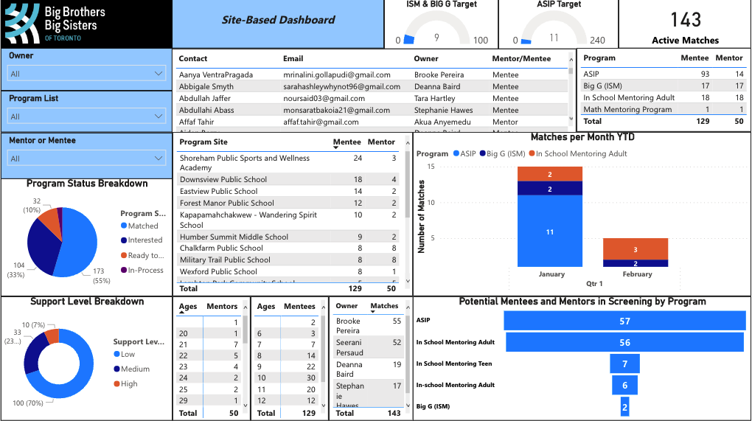
Metrics captured within the Site-Based Dashboard
Notes:
So first and foremost, As you can see, there is a lot of data presented just for site based. But what exactly does this dashboard tell us?
Lets break it down

Slide 43
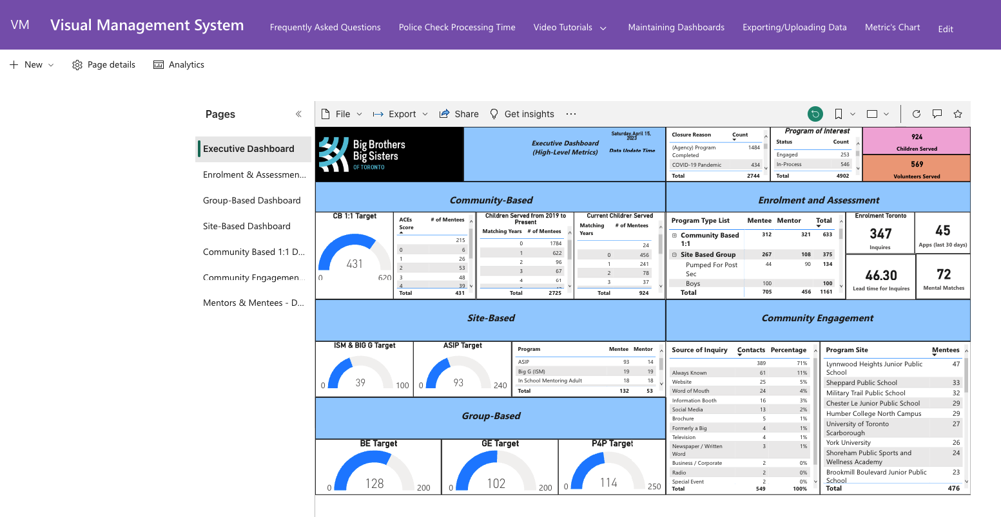
Optimizing Accessibility

Slide 44
Rounding the Corner on the Model is a Critical to Success Skillset for the Analyst
Information perception/ understanding/ insights
Information portrayal
Leadership & management team
(wisdom application, data/facts to information conversion process)
Data management and Operational Analytics
Data Organization
Decisions
Data entry
Actions
Data capture
Data capture
Data capture
Data capture
Upstream Systems and Inputs:
Suppliers & customer orders
The Business Processes/Value Streams
Downstream Systems and Outputs:
Orders Fulfilled
Data capture
Data capture

Slide 45
Decision-Action/Study-Adjust Support System Design and Development
Key Questions and Key Points:
Alignment between Information Portrayal (what’s portrayed and how) and the ‘requirements’ for decision to actions, adjustments, study-adjust driven by a sense of urgency to improve performance and realize benefits is critical.
How do we get what is typically an inter/multidisciplinary team of people, cutting across multiple functions,with IT perhaps at the ‘heart’ or ‘mind’ I guess of it, to wholistically and effective improve designs for Visible Performance Measurement Systems? What role can ISE play?

Slide 46
Introducing the OA Triangle Model
The Basic Roadmap for the OA Triangle
“Above the line” analyst role
What are the fundamental Questions that have to be answered?
What data elements do those questions require?
Organize the data and facts and then export to your analytics app.
Extract features from data through integration and manipulation of data that move us closer to answers. (torture the data)
Apply business acumen to data & analyses – create new knowledge
Apply data visualization techniques to aid in telling the right story – as in life, so in business: the best story wins …
Follow the ‘yellow-brick’ road
Most ISE/ILSS Process Improvement Projects require that the ISE/Belt do both roles, certification requires that
Data is almost never stored in a common place and are not trusted nor available
the current state process in many large organizations splits data and analytics
Data are stored in a common place, and are trusted and available

Slide 47
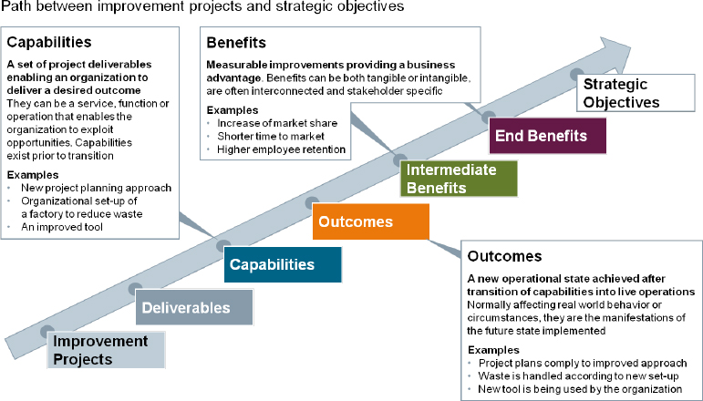
Operational Analytics enables us to understand this causal linkage to Benefits Realization and accelerates this causal path
Organizational Adoption & Alignment to Solution(s)
By What Method and How will We Know?

Slide 48
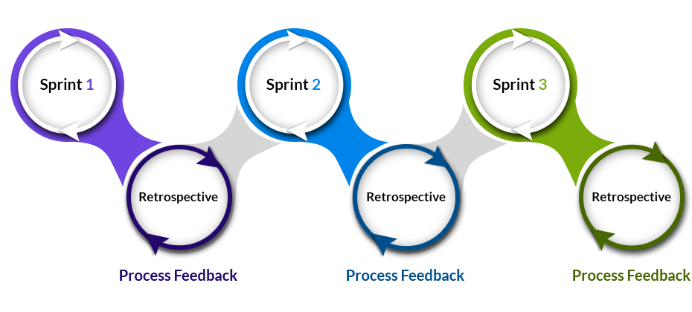
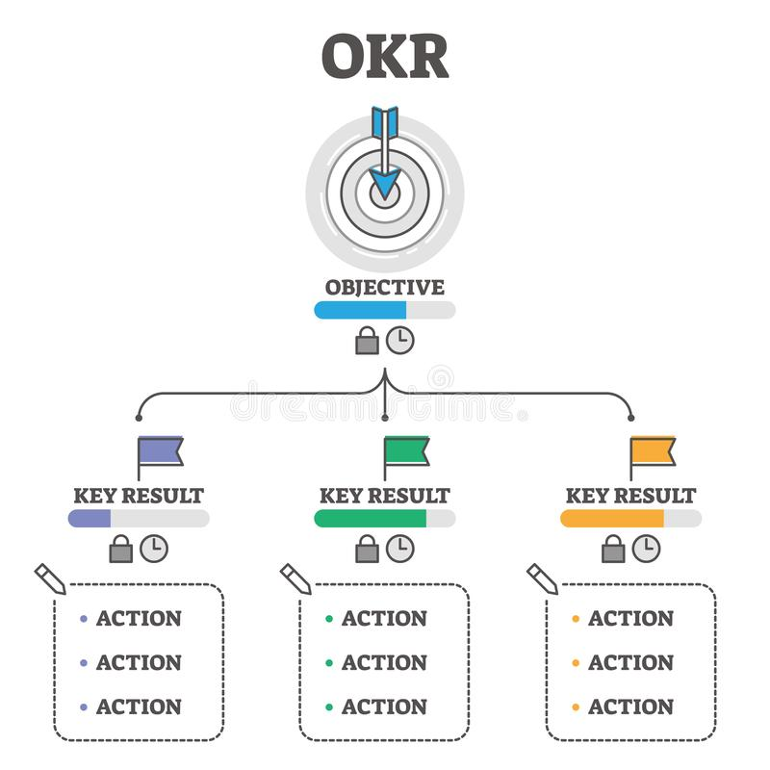
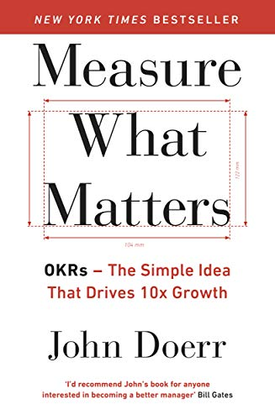
How can you do this really fast?
Notes:
Agile, Sprints, OKR’s, leadership alignment, speed of trust …..
Explain OKR briefly and how it connects with what we are talking about

Slide 49
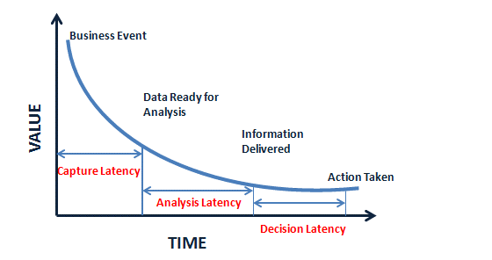
Getting to Visualizations that create insights (aha moments) that provoke timely decisions and actions and improvements is the key
Must do, Accelerate ability to cycle bottom to top on the OA Triangle
Improved Alignment of OA work with Strategy—better portfolios due to leveraging better OA
integrate data creatively, from multiple sources, rapidly using best tools available
Visualizations must minimize the latency to get to the “Ah-Ha” moment and then drive the causal chain to Benefits Realization

Slide 50
Key points--revisited
Good analytics come from good context understanding, use case clarity, good problem/opportunity statements, clear understanding of DONE
Good problem/opportunity statements have to be have an associated DONE and OKR’s (Objectives and associated Key Results);
Analysts need an all-access pass to data and facts & the wisdom and intentionality to collect it
Simple techniques trump complex techniques
Framing Analytics work in the context of ‘Good Strategy’ is super critical.
Some people have every skill – business acumen, data management, analytics understanding – to perform a good Operational Analytics – but it tends to result in a slow ‘craft’ development process for most
Analytics exists on a steep learning curve – what used to take six months now takes two weeks with the right data and analytics
There is little time for ‘craft’ in our business – speed wins
Operational Analytics, generally speaking, is not being ‘taught’. A few programs have outstanding curriculum but they are rare, in my view. They have over complicated analytics.

Slide 51
Key points--revisited
Investment in the data foundation has a positive ROI, as analysts move faster when they trust the data – results in faster results
Rule for Data Management: storage and speed are generally not issues any more, if it’s there store it, you might need it later (can always aggregate can’t get more granular if it isn’t there)
Second Rule of Business Intelligence/Op Analytics – maintain the illusion of simplicity for your customers, Understand the Use Case and the stakeholders keep it simple for them. If there aren’t ‘aha’ moments in your work you’ve failed.
Good data visualizations can tell the right story quickly, because people are predisposed to believe what they see in a chart …
Be on guard! Some folks use How to Lie with Statistics as a field guide
Kahneman’s (Thinking Fast and Slow) and other research on Decision Making and Action Taking Styles and Methods are invaluable prep for Operational Analytics Specialists.
Apply Pyramid Principle Thinking and Logic, learn to ‘Resonate’/tell powerful stories with your data to provoke improved study-adjust and business value creation.

Slide 52
Key points
There is very positive ROI in getting Operational Analytics well designed and developed– small analytics teams can wield disproportionate influence on the bottom line
Hire Intentionally and Intelligently– there are few people who have the curiosity, sense of urgency, tolerance of ambiguity, and humility for this role
The catalyst, change agent role is very powerful when powered with great Operational Analytics – get in, learn, analyze, win, get out
Portfolio Management is everything, it’s a very dynamic process.
Understand the causal ‘chains’ and stay focused on ‘drivers’ and critical enablers, focus on the right ‘levers’
Good Operational Analytics provokes more timely decisions and actions – indeed, in most organizational systems, simple and persuasive/influential beats complex/ambiguous every time
Learn to Tell Stories on individual Slides and ‘Decks’ that Provoke timely improvement and accelerate benefits realization
Be a fast follower with Analytics Technology, people are enamored with shiny objects, keep it simple, more toys and elegance lose, pragmatic Operational Analytics aimed at rapidly improving process performance wins.
Stay focused on developing Process Maturity Levels systematically over time and use data/facts to support progress

Slide 53
And, Just Ahead…..
June and July Offerings for you..
An Analytics Mini-Series:
27 June—Operational Analytics 201
Register for Op Analytics 201 with this link
14 July—(401) Best Practice Case Study—Data and Analytics at University Health Network, Toronto
(OA 401) Register for Best Practices in Analytics UHN Toronto
18 July—Operational Analytics 301
Register for Operational Analytics 301
Capstoned by a Feature Article in the ISE Magazine in August.

Slide 54
OA 201 is up next…27 June
OA 101: DEFINE--Foundations for Building Performance Measurement, Evaluation, Improvement Systems
Systems Thinking and Process Breakdown Structure
The ‘Management Systems Model’ (Management Systems Engineering)
OA 201: CONCEPT DESIGN--
The ‘Operational Analytics’ ‘Triangle’ Model
The ‘Questions’, where do we start with Op Analytics Development Projects?
Picking the right improvement projects, Portfolio Management, Using Op Analytics as a tool for picking the right improvement projects (how Op Analytics helps with P and S)
Seeing, understanding Op Analytics as an integral component of the PDSA, System and Process Improvement Methodology and work
The Data Design, Development, Management Role
Concepts to help with data modeling, data ‘base’ development
Creating the foundation upon which Analytics Tools sit and can be fully utilized
The Data to Information to Insights Role

Slide 55
Certificates and Certifications
Stick with the Series and earn an OA Certificate with CEU’s from IISE.
Consider IISE’s Operational Analytics Certification.
An on-demand course that takes this Series a level deeper, works on skill development.
Essentially a 4 ch level, Semester Course in OA.
Tailoring and coaching encouraged and provided.
For more on this, please contact James Swisher jswisher@iise.org

Slide 56
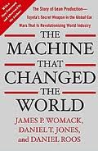
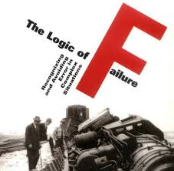
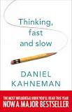
Context – reading list provided from Intel Global SCM Analytics team member (Moneyball is a great movie if you haven’t seen)
Journey from craft to volume
Profit from fixing inefficiencies
Understand why things fail
Recognize human biases

Slide 57
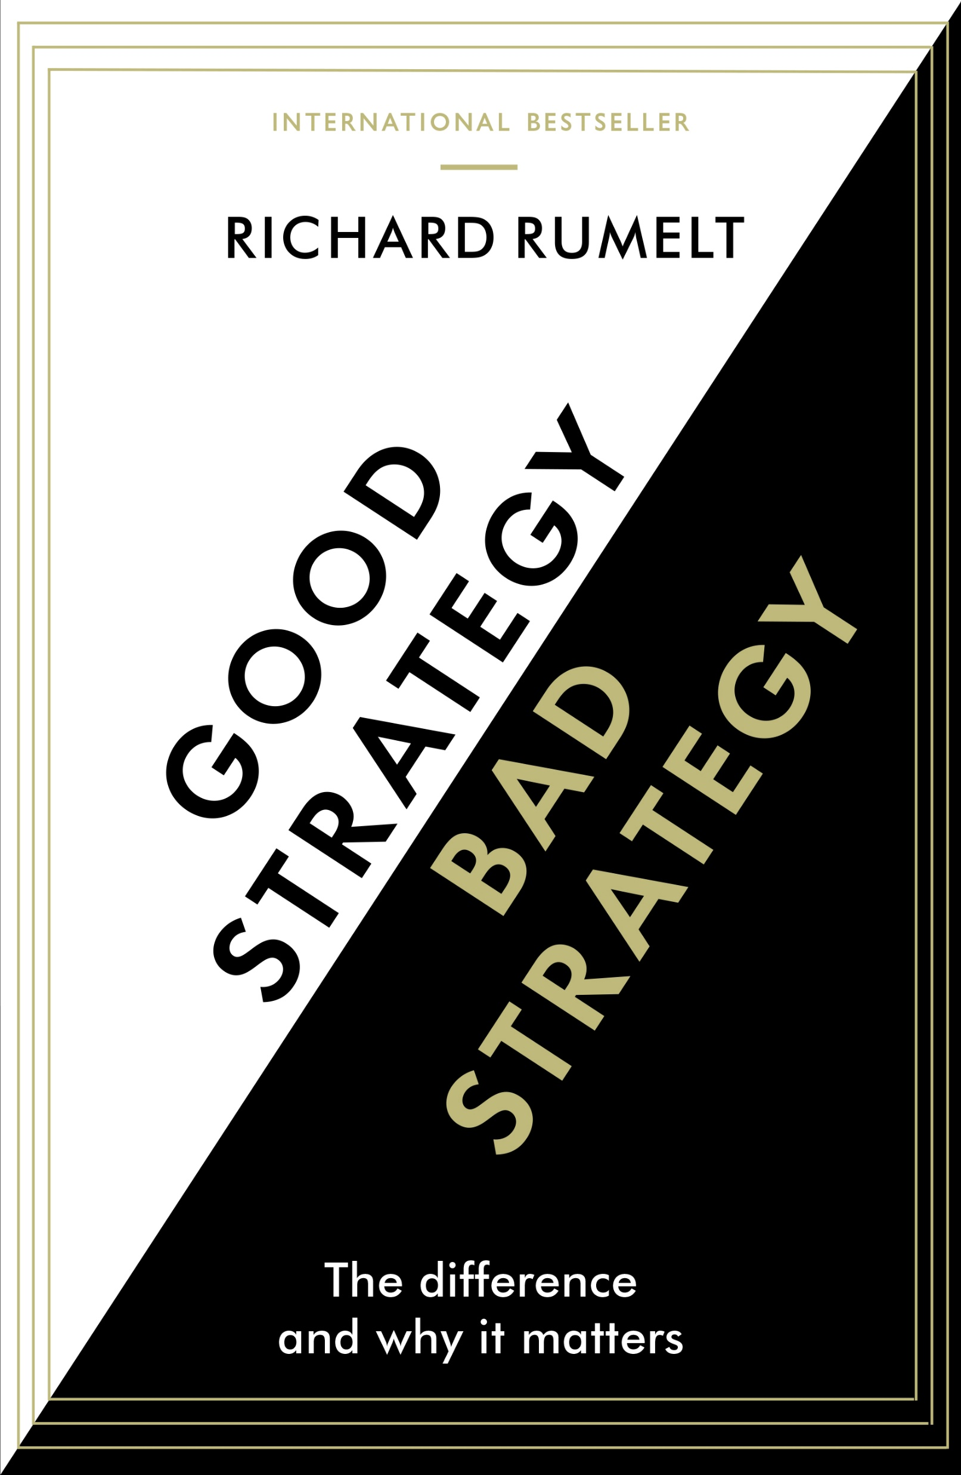
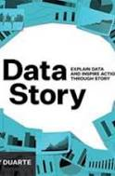
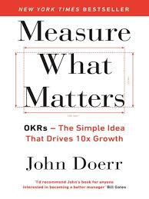
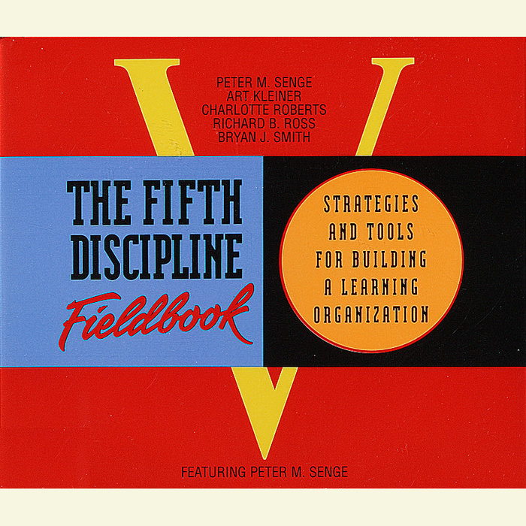
Illustrative Contextual Fundamental Guiding Principles for Analysts—For Further Study
Operational Analytics Certificate & Certification Program

Slide 58
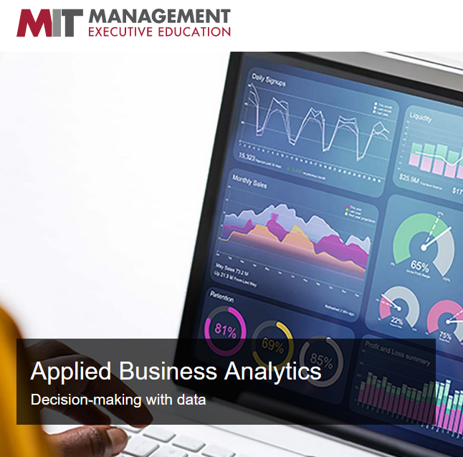
Op Analytics Development Options
120 hours ++, $400 students + $250 for certification
$475/675 member/non-member + $550 for the certification
4 days to 6 mos. $600-$5,000
1-2 yrs, $50-100k
Time/
Cost
On-Line, Virtual
On campus or Hybrid MS Programs
Hybrid/ Blended Model
https://careerfoundry.com/en/blog/data-analytics/best-data-analytics-certification-programs/

Slide 59
Op Analytics represents huge opportunity for ISE’s
In Partnership with:
The Poirier Group
Moresteam University
Delivered Uniquely:
IISE Digital Op Ex ‘Mall and Stores’
10+ Video Modules for easy, self-paced consumption/learning
‘Chat’ Support with Coaches
Periodic Huddles for virtual coaching
Certificate requires an on-line final exam
Certification requires the Certificate plus a reduction to practice, proof of skill project
Module 1: OA Thought Leader Perspectives
Module 2: Operational Analytics Perspectives, Points of View and Foundational Principles and Methods and Models
Module 3: Operational Analytics: The Foundational Data Management Role
Module 4: Operational Analytics: The Analyst, Decision/Action Support Role
Module 5: Data Sciences and The New Industrial and Systems Engineering
Module 6: Operational Analytics: The Evaluation Role
Module 7: Operational Analytics—Visual Measurement/Management Systems (Parts I, II, III)
Module 8: Operational Analytics: Putting it All Together: Case Studies
Module 9: The Role of Data and Information (Engineered Management Systems) in Periods of Major Disruption, Reducing the Latencies
Module 10: Creating Cultures that Support Full Potential Performance/Operational Excellence

Slide 60
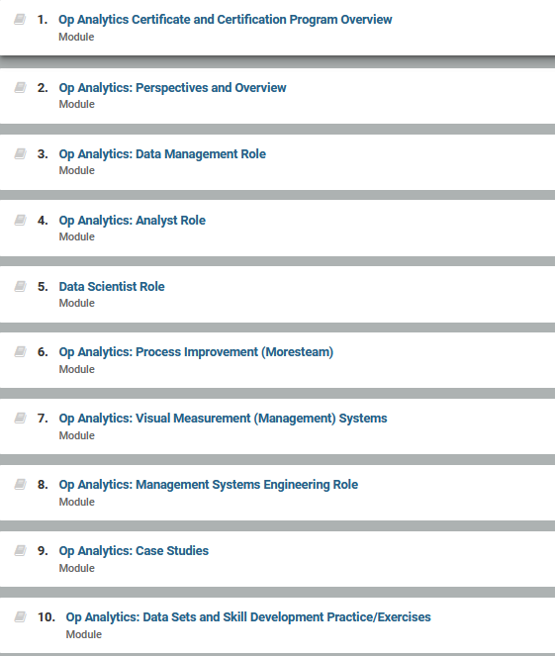
10 fundamental modules make up the certificate program. On-demand Learning Management System. Chat Coaching and periodic ‘huddle’ coaching included. Approximately 120 hours of studying designed to be completed in 6 months or less.

Slide 61
Feature Extraction
Key Results/Key Performance Indicators
Organizational System Key Result Area (KRA’s)
One of the critical roles of the Analyst is to ‘understand the system’ (Deming’s Profound Knowledge) causally and select the right metrics (Measure What Matters).
This is the essence of Feature Extraction.
Often this comes right from Value Stream Mapping and the identification of ‘control points’ (spots in a process were we do or can or should capture data and also where we can ‘manage’ the process).
Effectiveness
Efficiency
Quality
Productivity
Innovation
Quality of Work Life
Profitability/Budgetability
Sustainability/Resilience/Optionality

Slide 62
Zoom In: Saltine Line Control Points
3rd Floor
Waste = 12.77%
(production)
4th Floor
Waste = 1.66% (production)
MIXING
Waste = 3.97%
(0.56% production)
SHEET ROLLING
Waste = 12.01%
(1.70% production)
STACKING
Waste = 63.49%
(9.00% production)
BAKING
Waste = 2.82%
(0.40 % production)
WRAPPING
Waste = 17.71%
(2.51 % production)
This problem is nothing new and has actually been the focus of prior improvement projects.
We will take a look at 2 project that have sought to reduce the process variability and in turn, reduce waste.
Notes:
From observational study (sample size, power of sample) →

Slide 63
Knowledge Extraction
Key Results/KPI’s (outputs from analytics
Data/Facts portrayed in a way that creates insights, tells a story, helps us see and understand, answers questions (Learning to See)
Lead Time
Throughput Capacity
Process Capability
Yield Loss
Cycle times
Takt time
Engagement
Competency Level
Process Maturity Level
Temperature
Pressure
Etc., etc…..
Analysts in Training struggle mightily with the difference between Feature Extraction and Knowledge Extraction and it can be subtle but often is very distinct and critical to success.
There is an art to it which is why it’s difficult to teach and at times difficult to master.

Slide 64
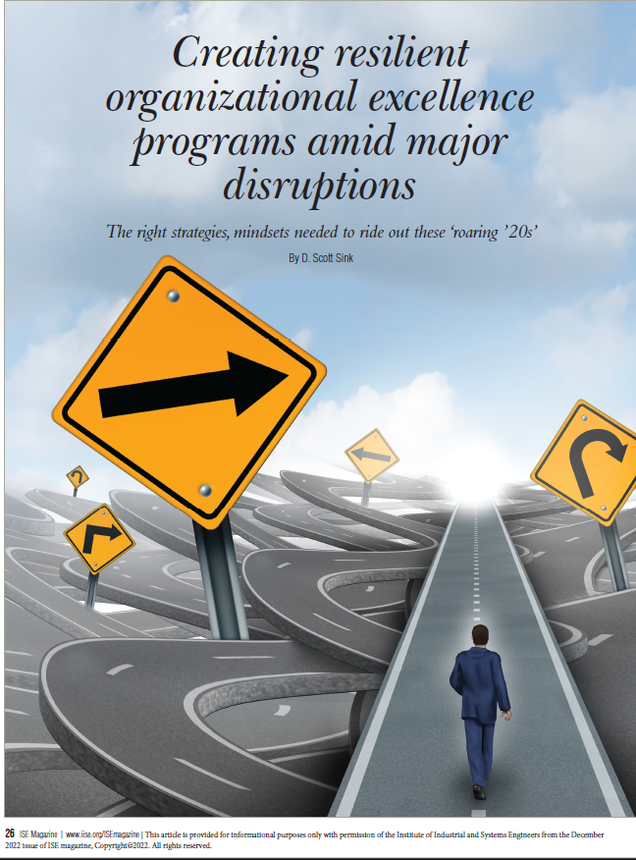
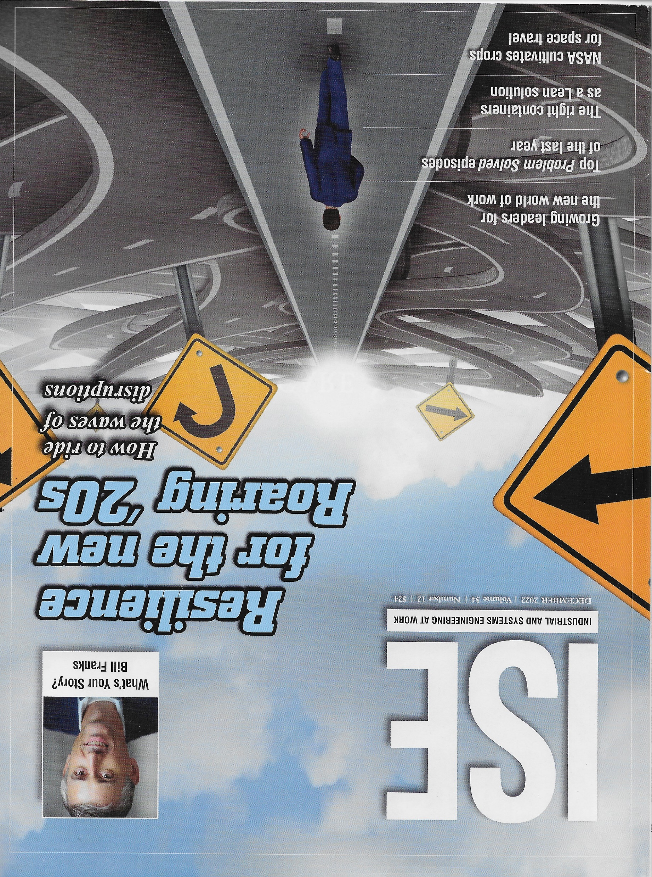
Webinar and Article ‘Offer Elements’ Plan & Calendar
Q4 2022 Theme—Org/Op Excellence in Turbulent Times
September—Insightful Leadership: Surfing the Waves to Organizational Excellence (Jim Tompkins)
September—Creating Improved Operational Excellence in Times of Economic Uncertainty and Challenges (David Poirier & Jim Dobson)
December—Planning to Improve Productivity in Disruptive Economic Times (Scott Sink)
120+ on-demand Professional Development Webinars in 10 categories of Performance Excellence
Just for you!!
Click here to go to the IISE Perf Excellence Website page

Slide 65
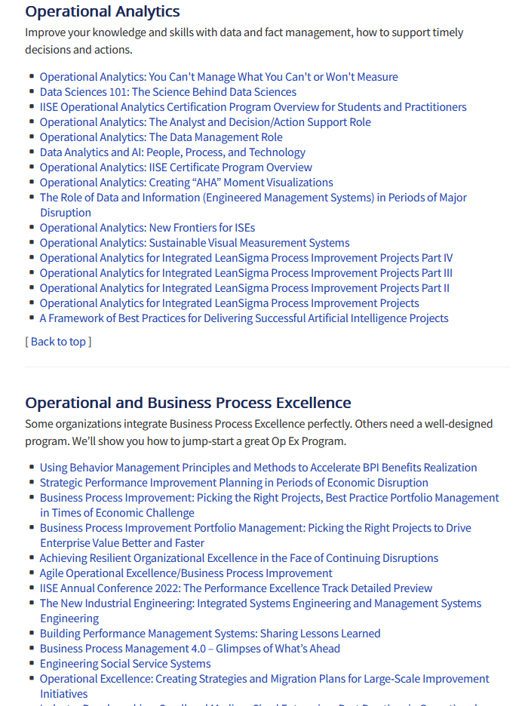
We’ll build off our Op Ex/Analytics Series past and just ahead
120+ on-demand Professional Development Webinars in 10 categories of Performance Excellence
Just for you!!
Click here to go to the IISE Perf Excellence Website page

Slide 67
Moving from Ad Hoc, Process Maturity Level 1 with Operational Analytics to PML’s 3-5 as appropriate.
A nice picture for Op Analytics I think…

Slide 68
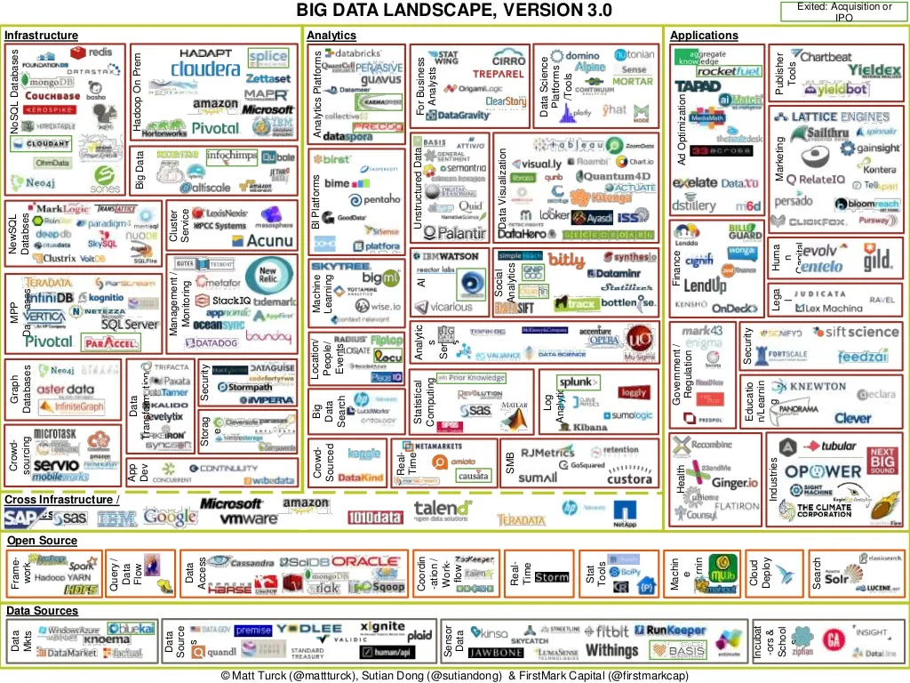
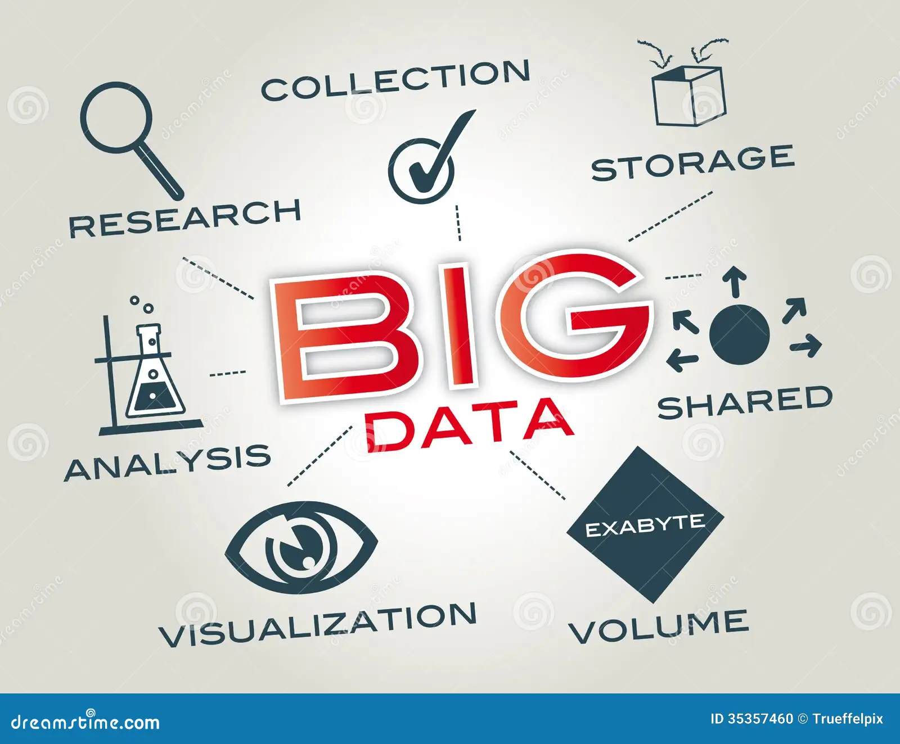
https://hbr.org/2012/10/the-true-measures-of-success
https://hbr.org/2017/05/whats-your-data-strategy

Slide 69
Operational Analytics, done right, minimizes latencies and enhances ability to drive more rapid benefits realization
Executing the Analytics Triangle effectively enables more rapid decisions and actions and positions for more rapid benefits realization.
Reduce the cycle times on each step in this implicit process

Slide 70
Operational Analytics, done right, minimizes latencies and enhances ability to drive more rapid benefits realization
Benefits Realized
Capture ROI faster

Slide 71
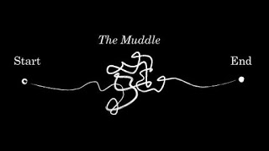
No Time for Muddle….it’s a time for “Triple-Loop Learning”

